Slide 1
GIANT WHEEL
FABRICATION PROJECT
COURSE: TA201A
SUBMITTED BY: K.S.Abhigna
200481
INSTRUCTOR: TECHNICAL STAFF: TUTOR:
Dr. Shashank Shekhar Indra Pal Singh Dr. Vivek Verma

Slide 2
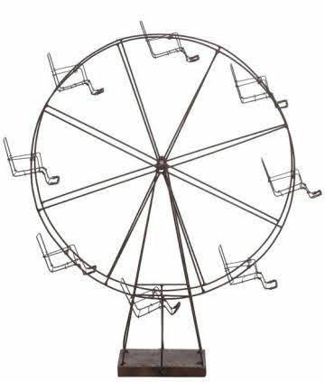
REFERENCE:

Slide 3
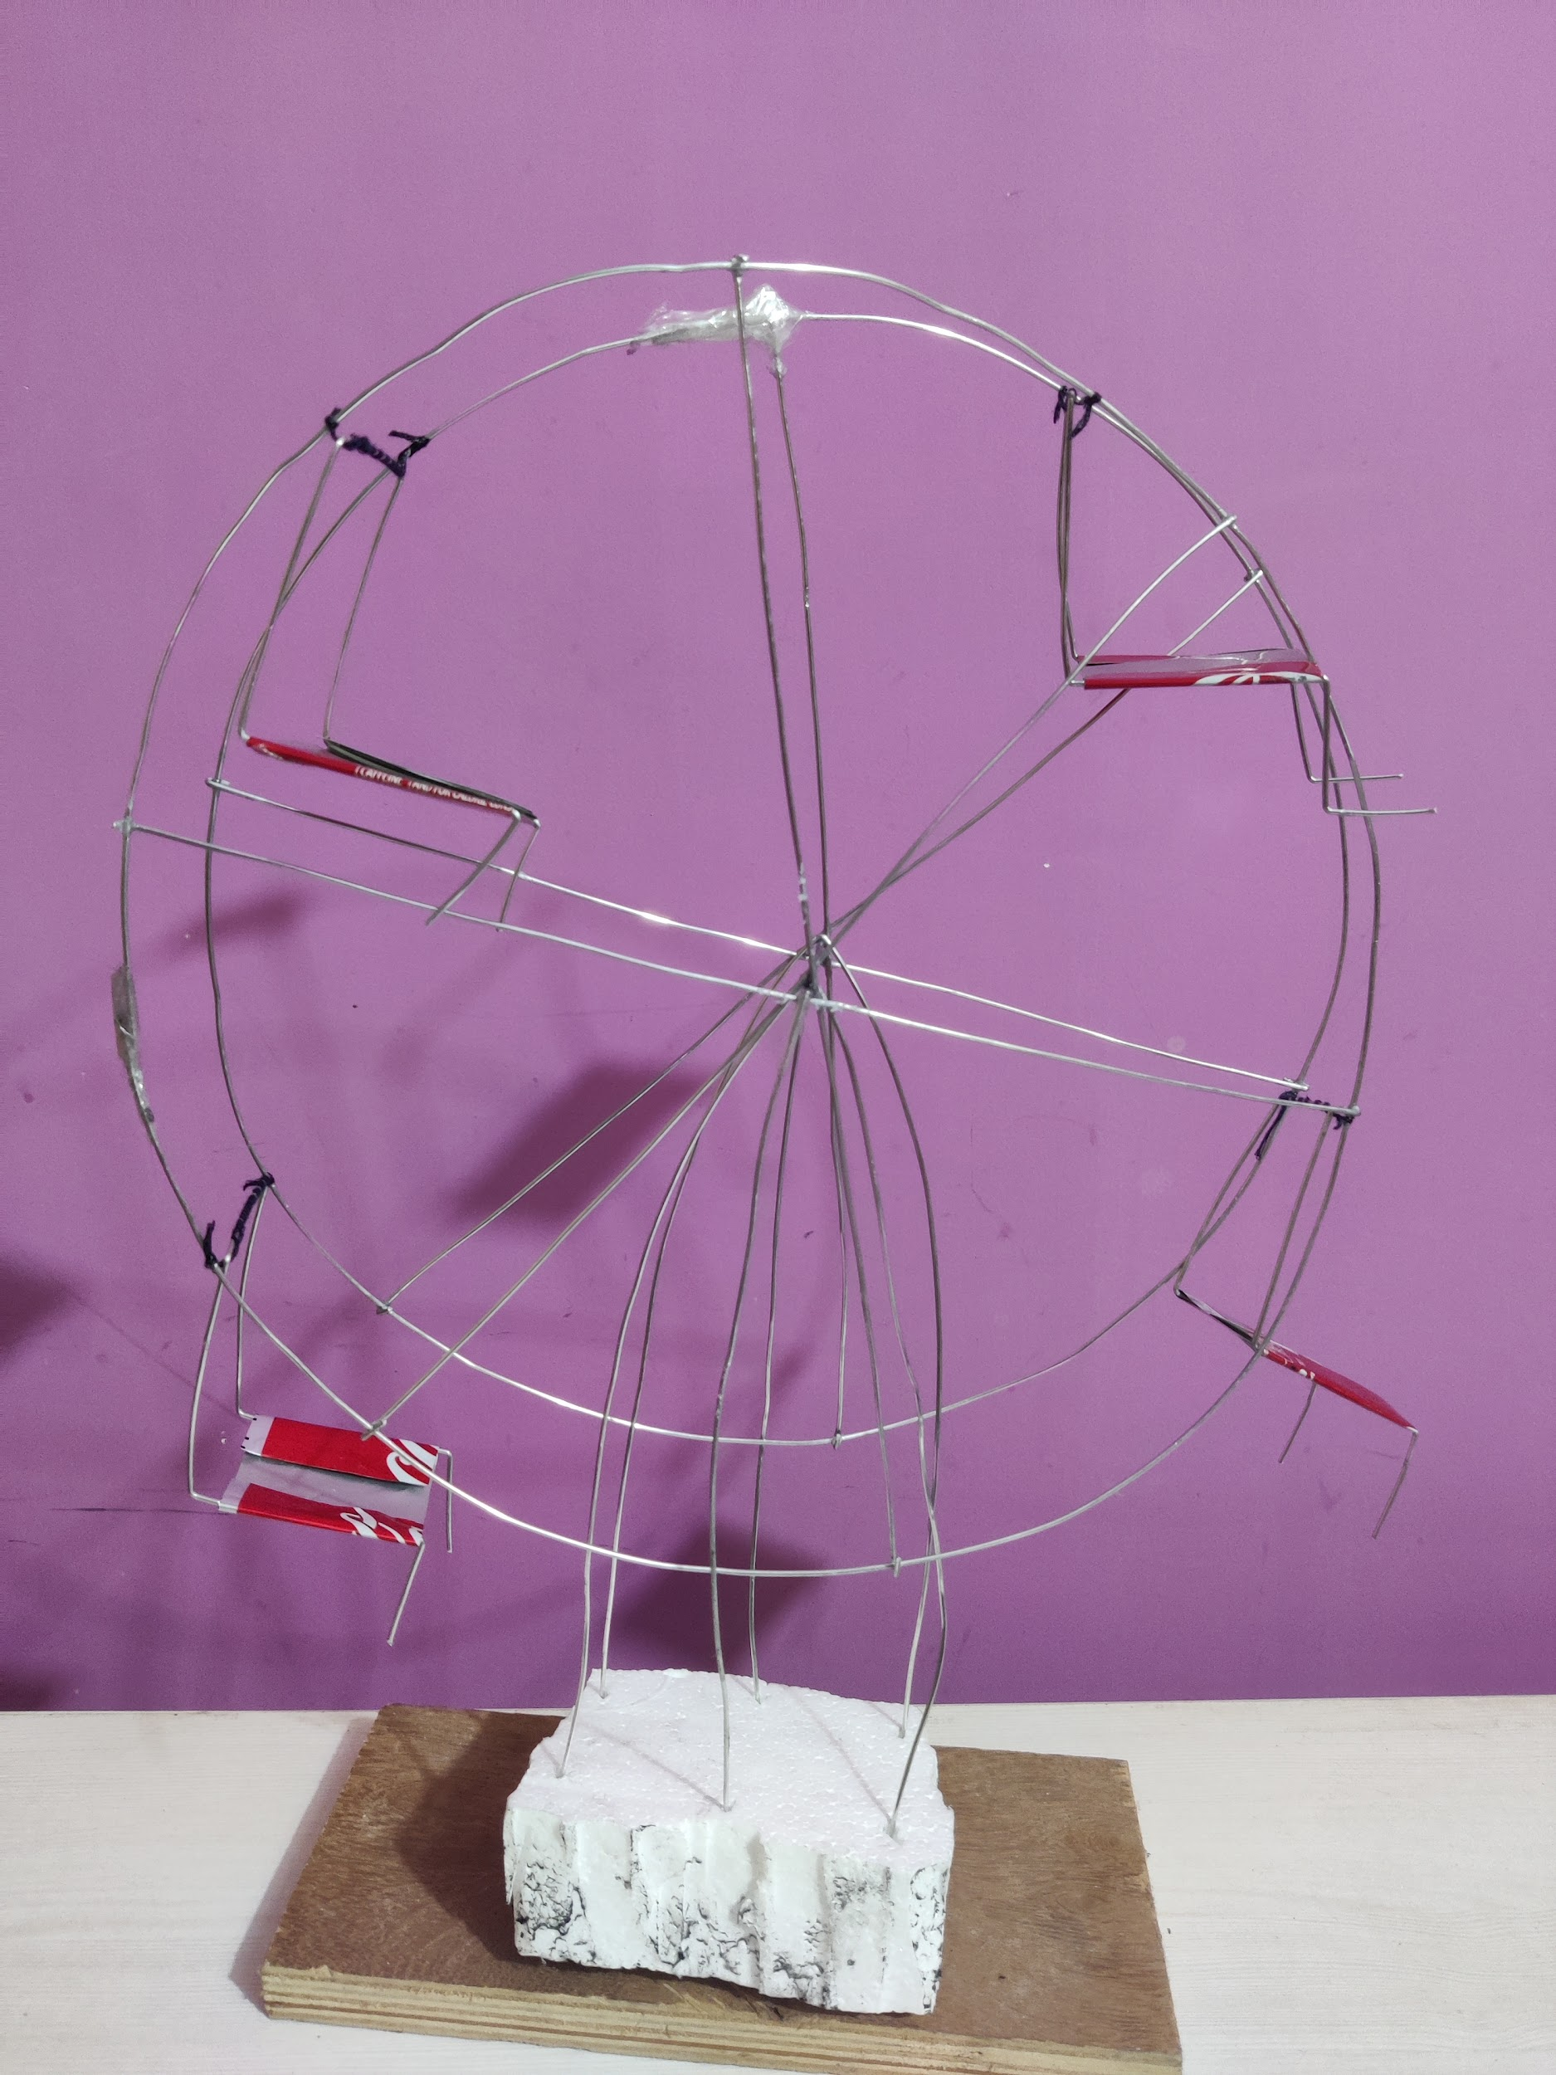
FINAL PROJECT:
Wheel
Size: 350mm × 300mm × 50mm
Chair
Base

Slide 4
MATERIALS REQUIRED:
Aluminium Wire
2 Cans
Thermocol
Fevikwik
Transparent Plaster
Wooden Plank
TOOLS REQUIRED:
Pliers
Scissors

Slide 5
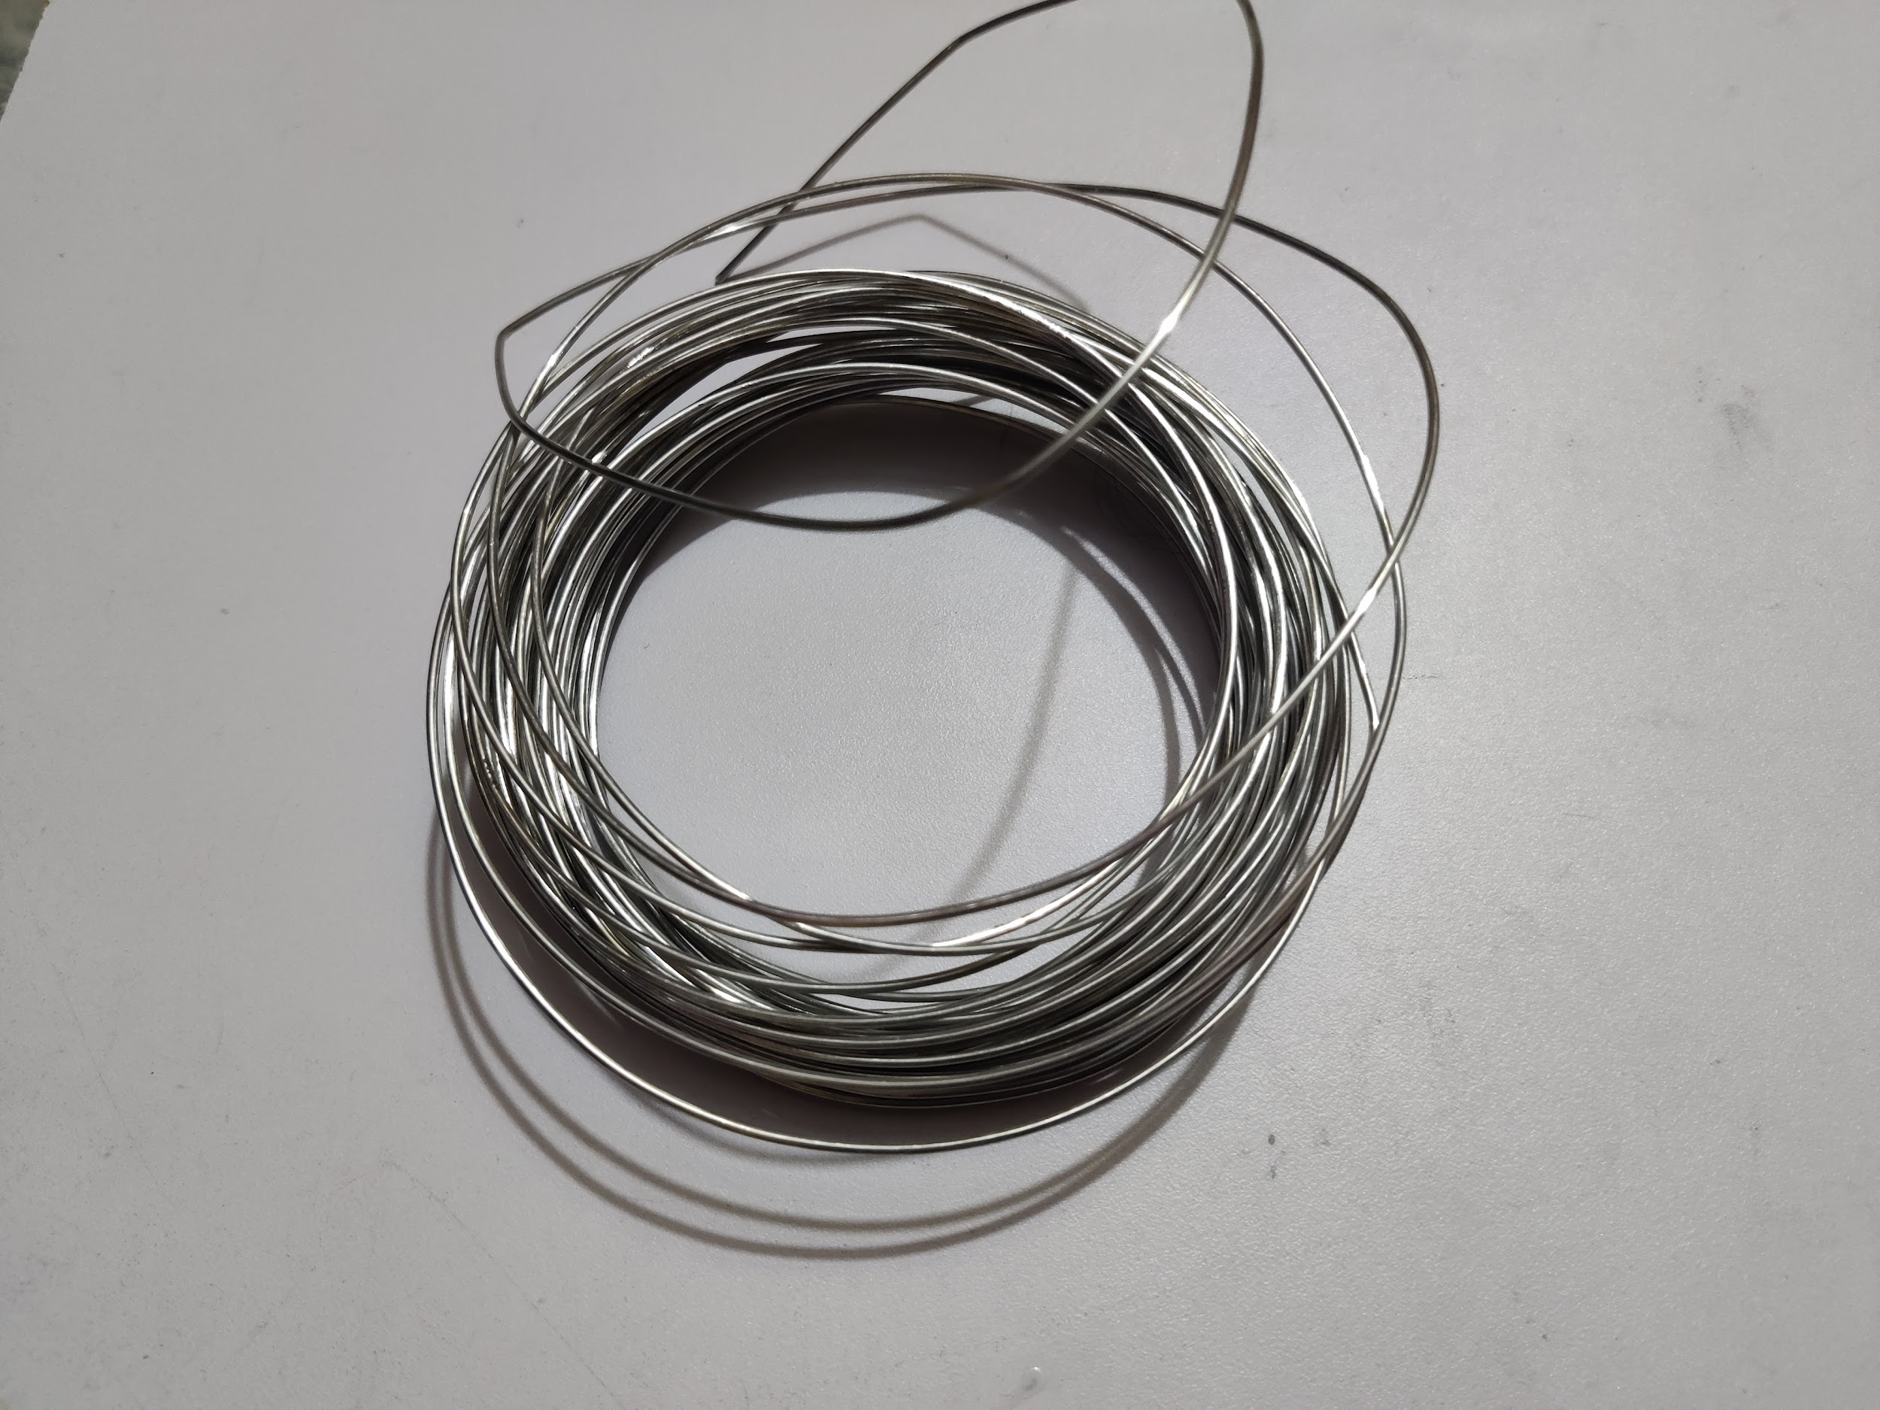
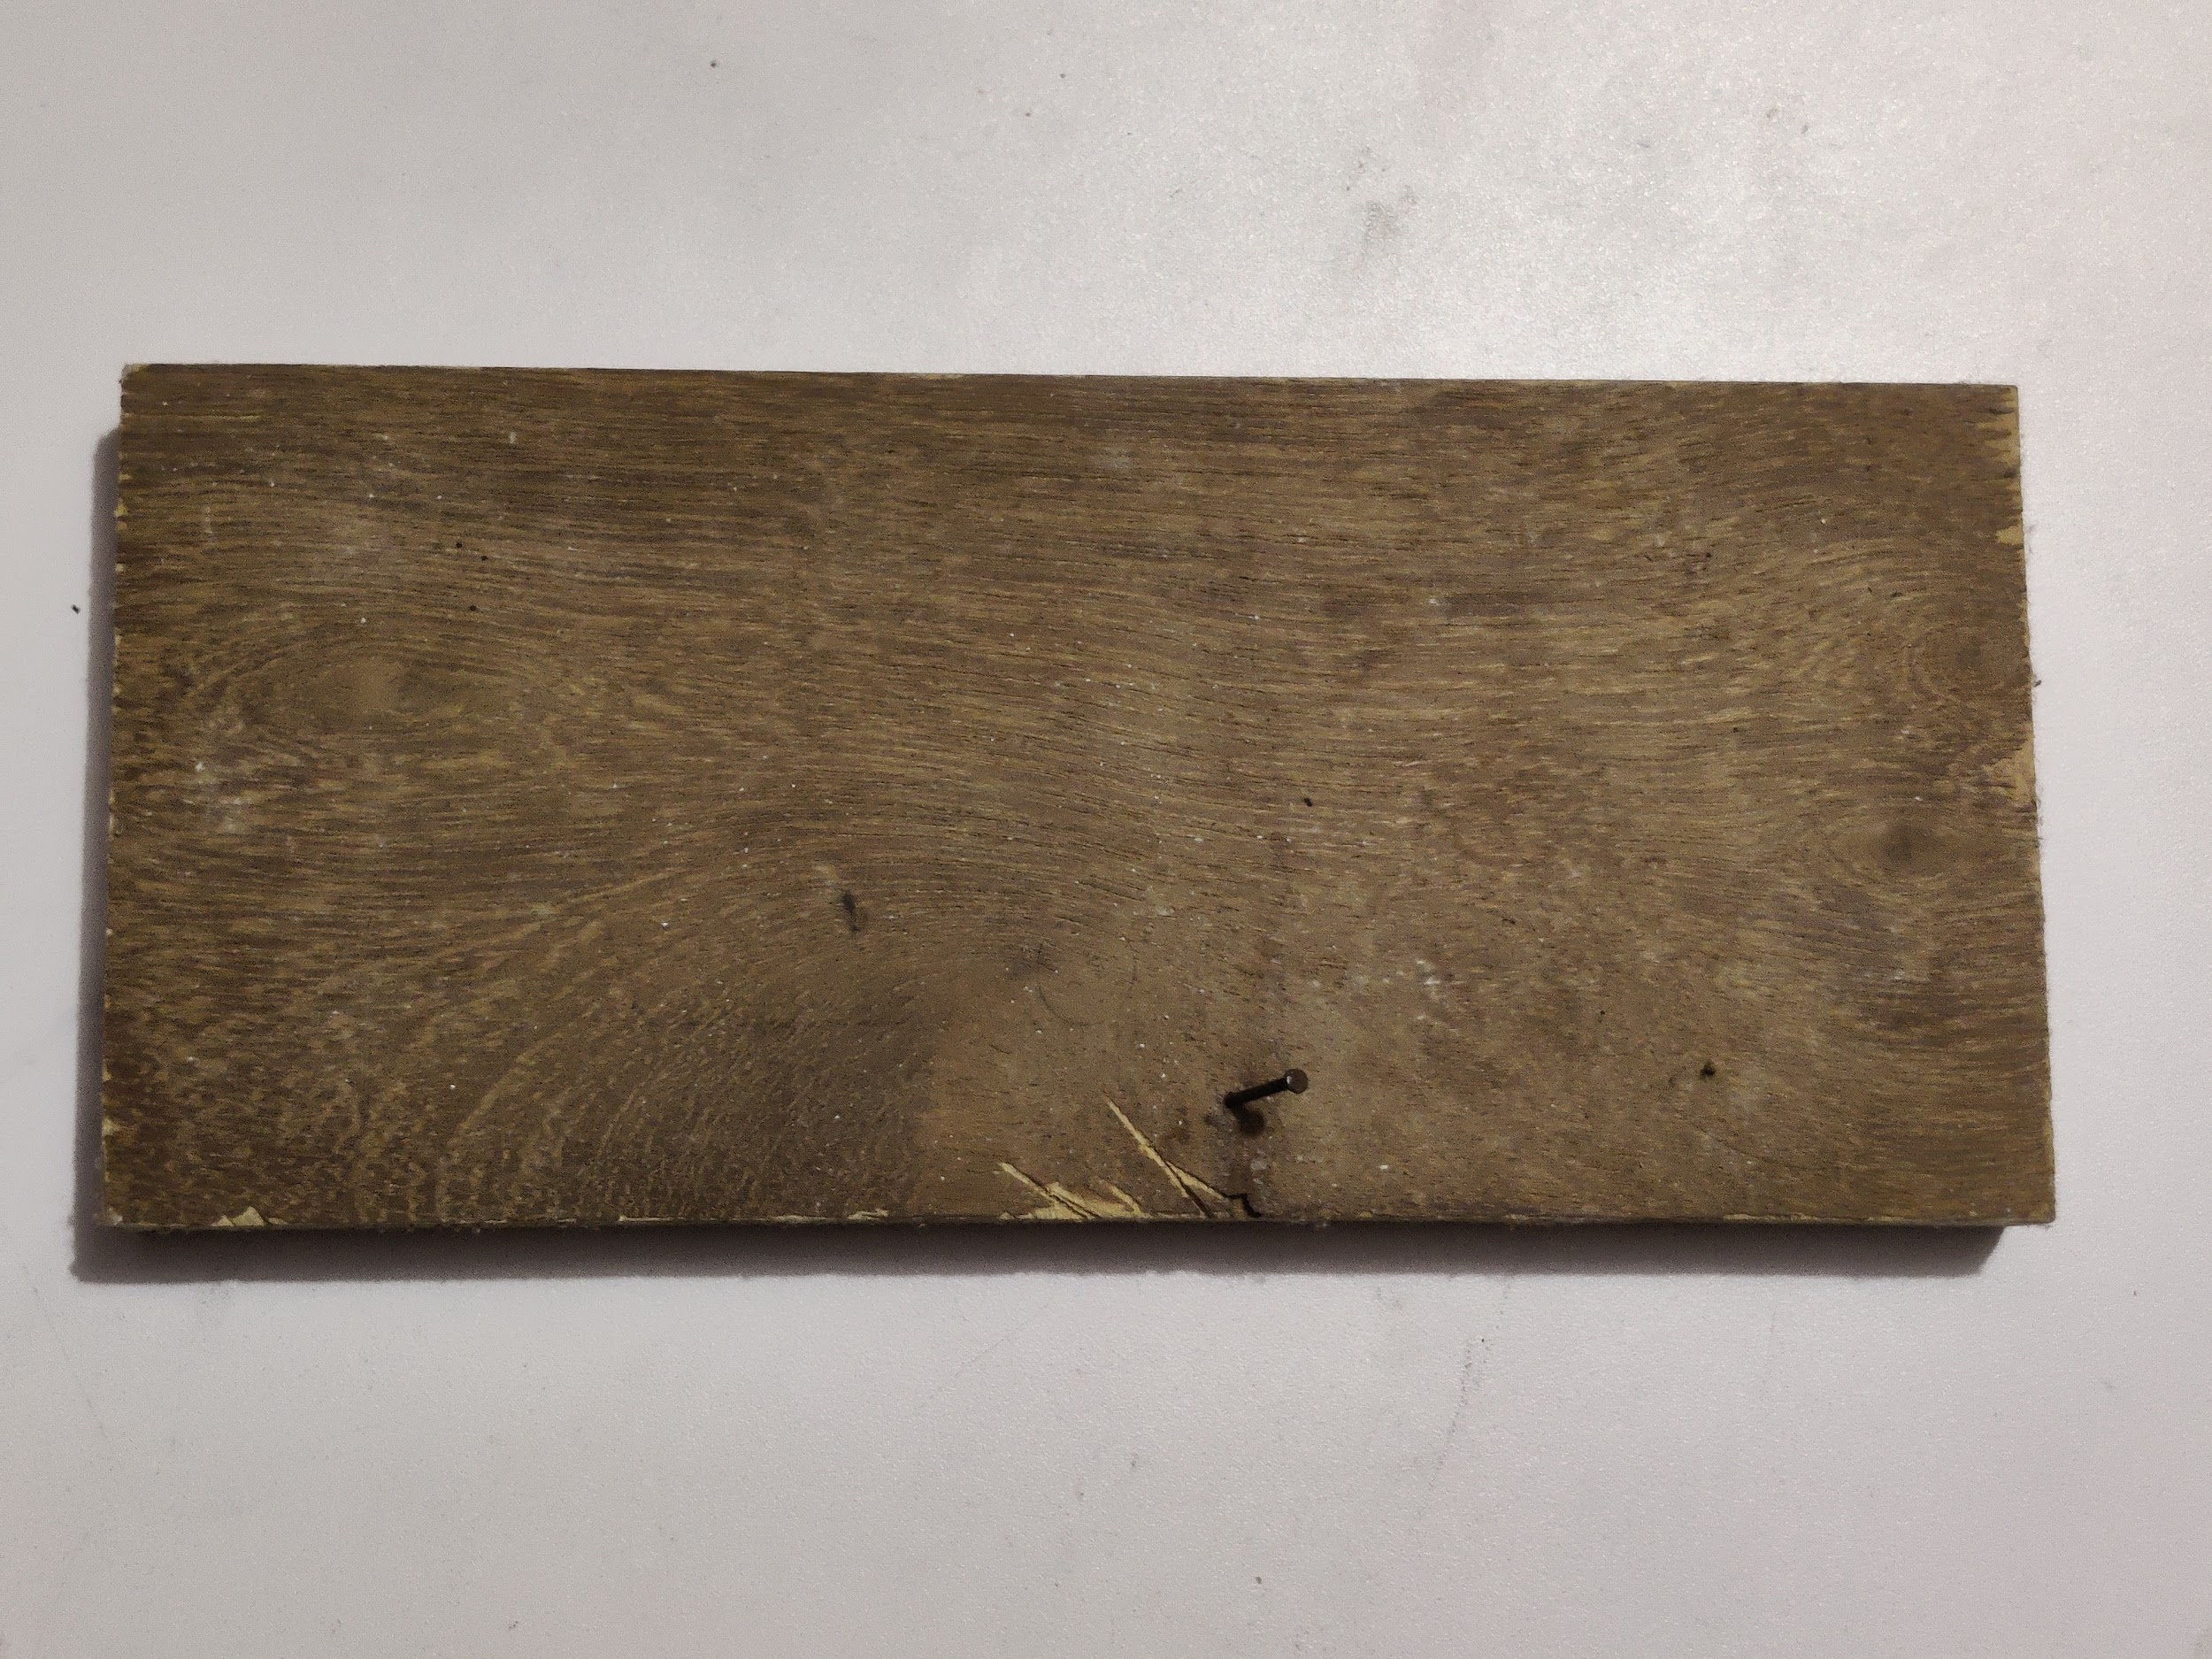
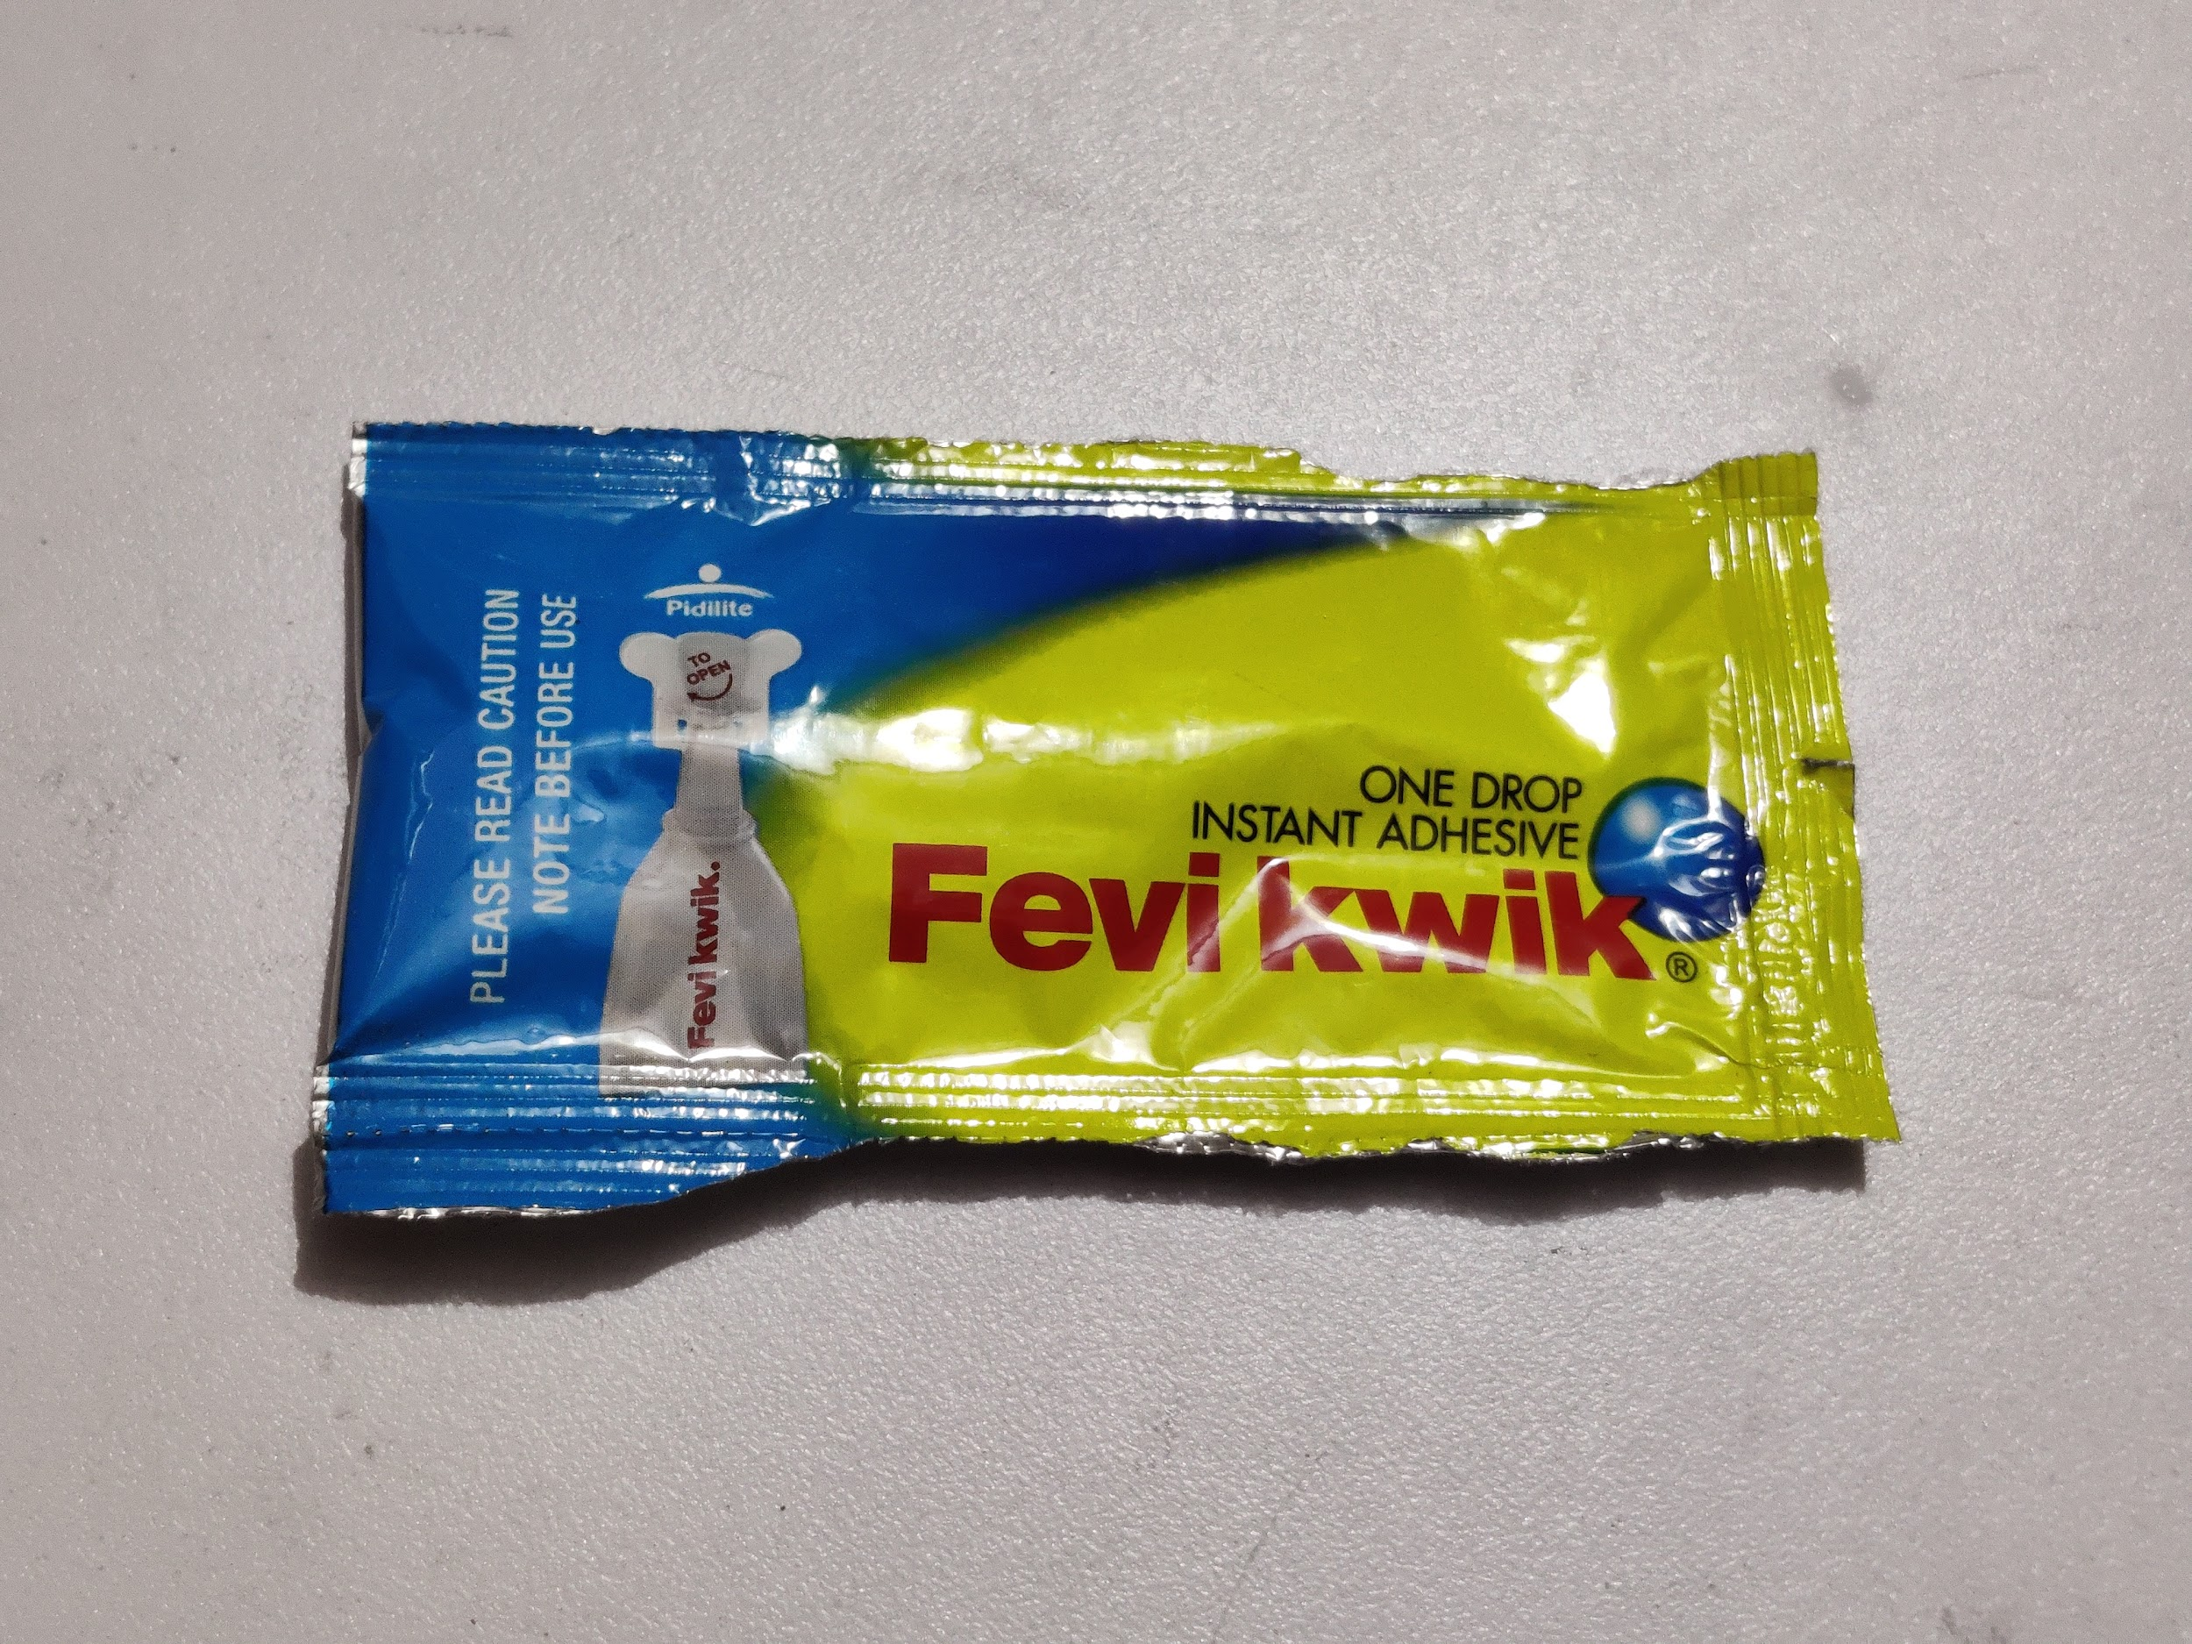
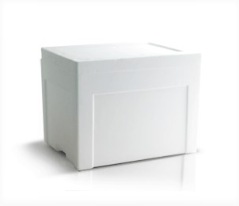
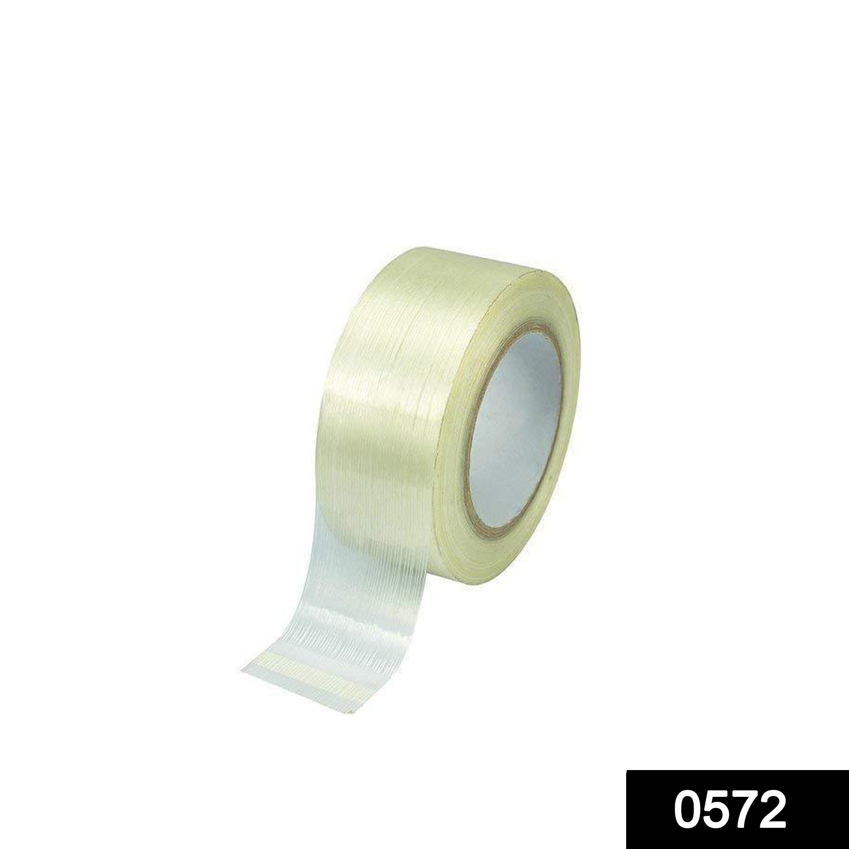

Aluminium Wire Wooden Plank Fevikwik
Thermocol Transparent Plaster 2 Cans

Slide 6
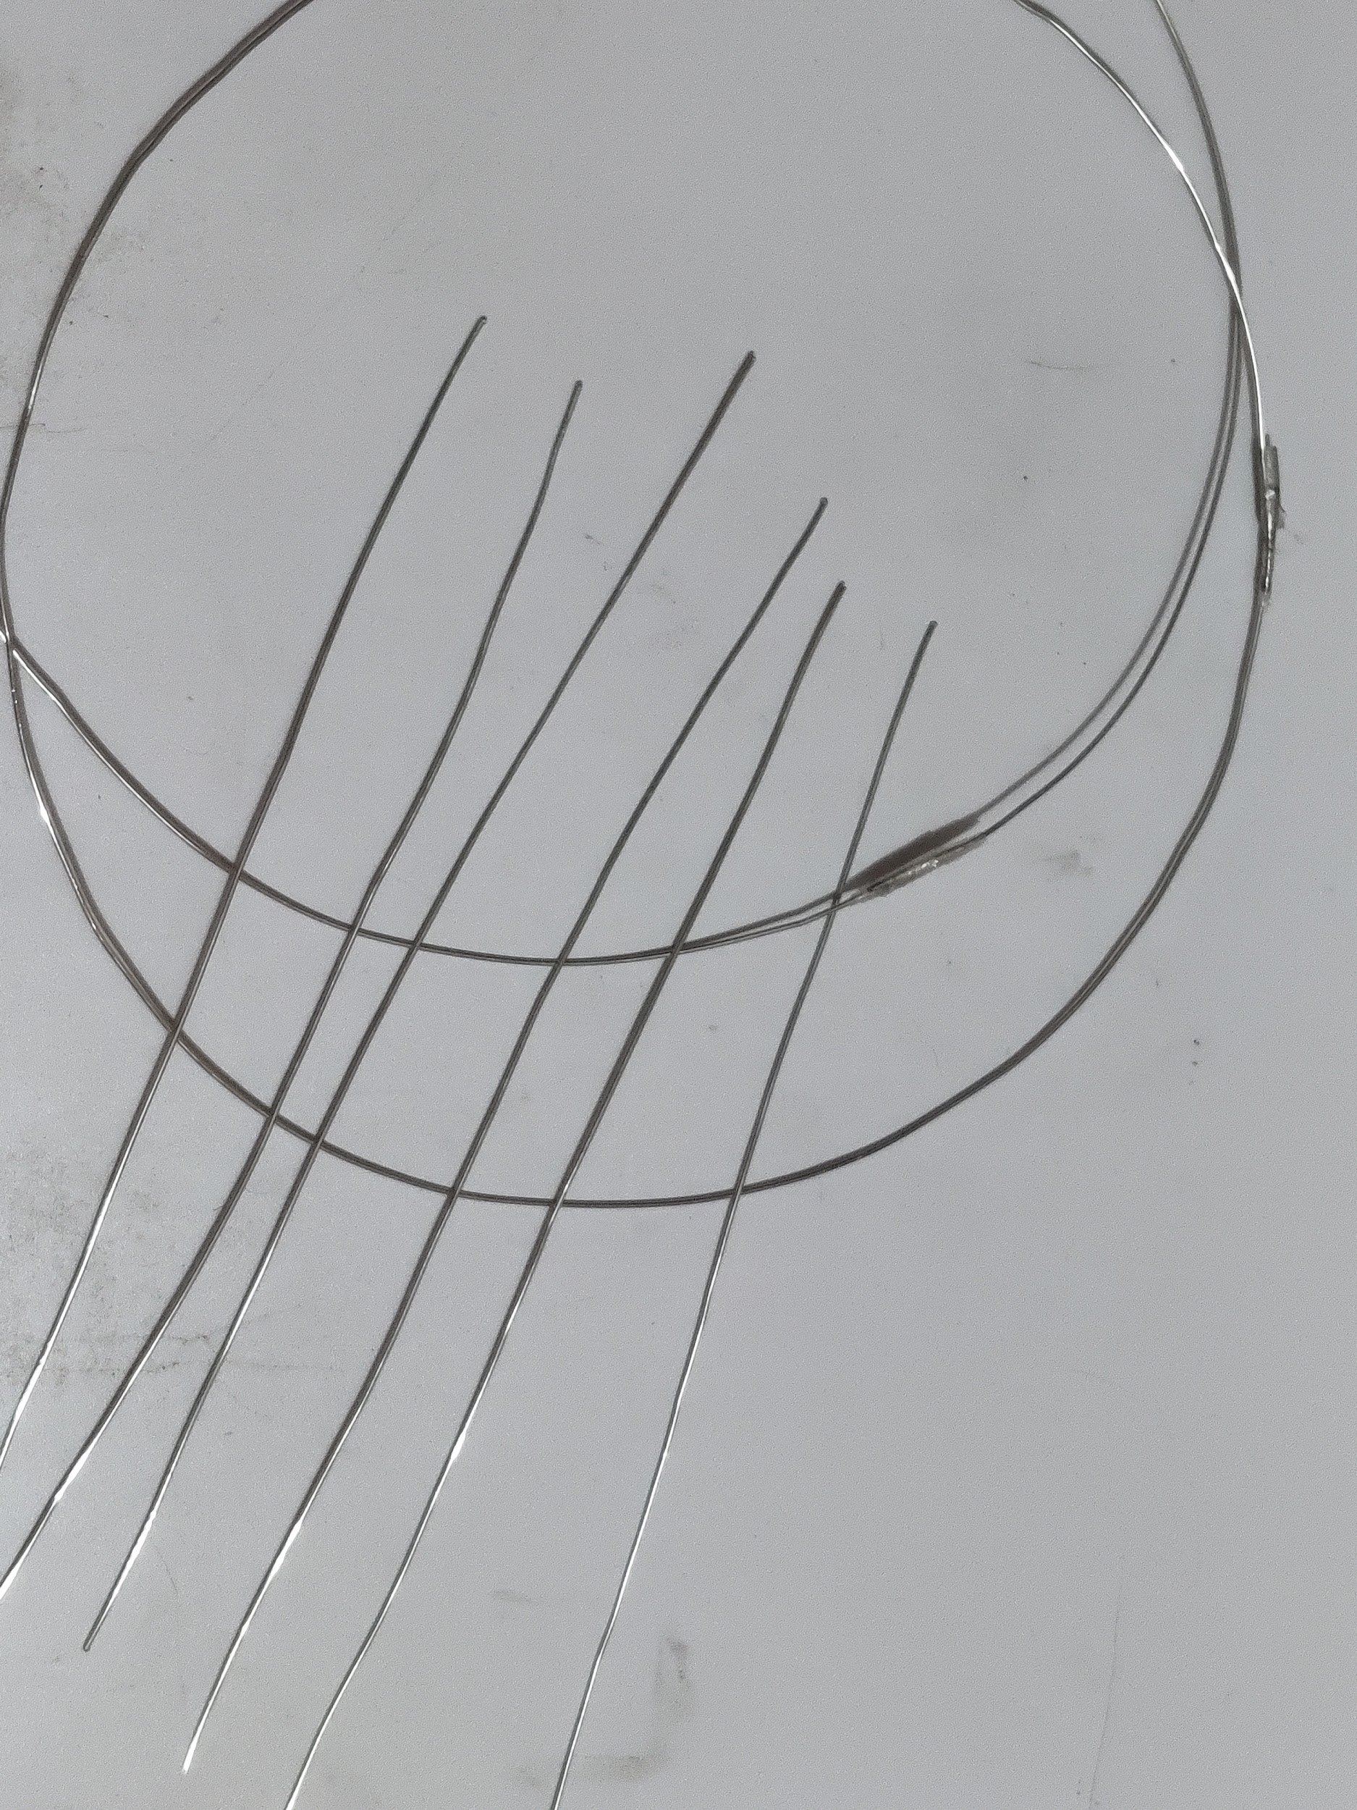
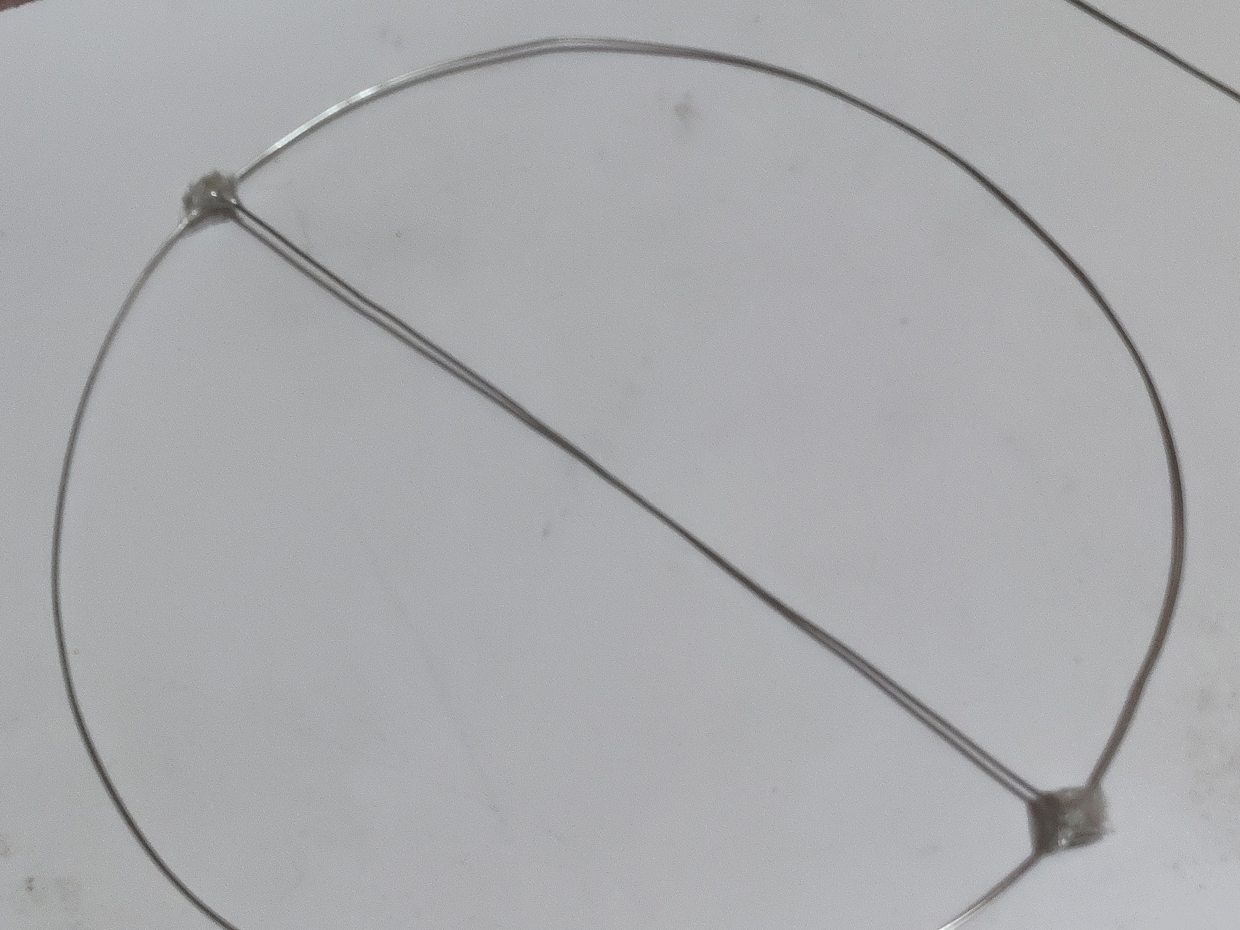
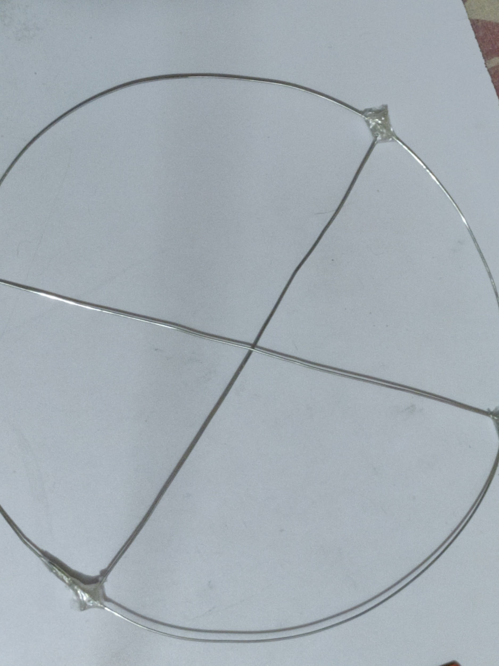
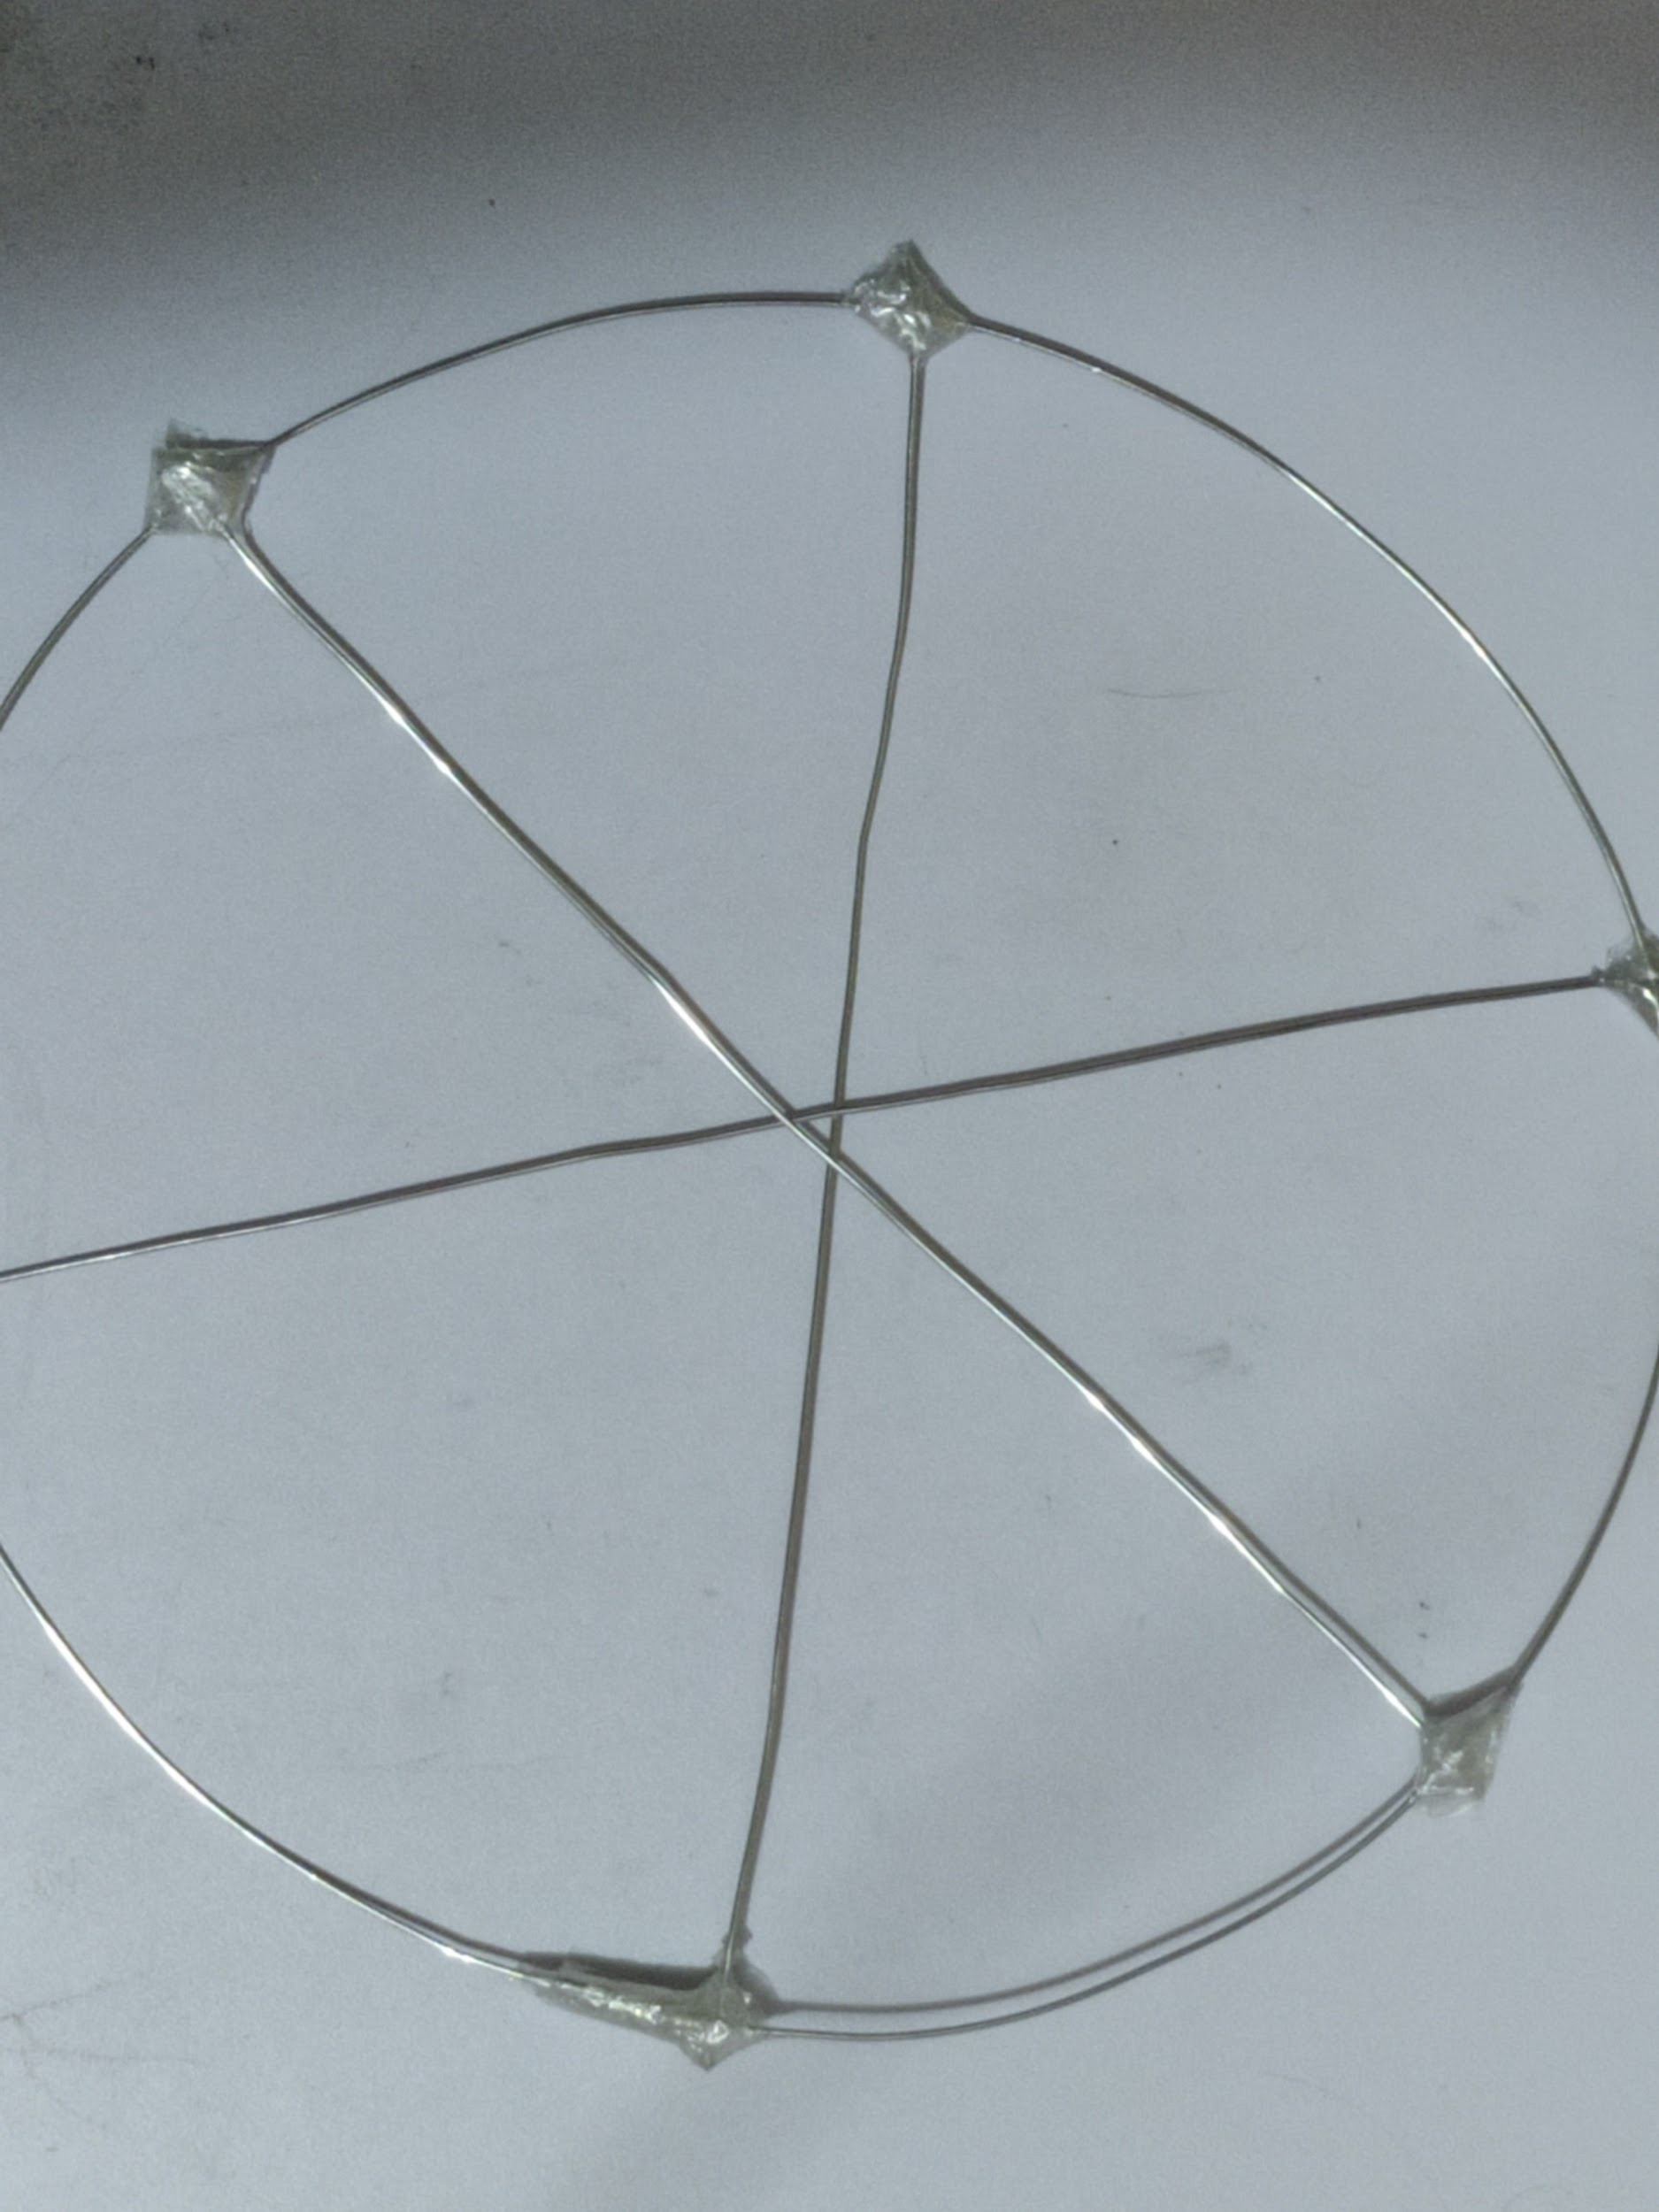
PROCESS OF MAKING WHEEL:
Processes Involved:
1. Bending 2. Cutting 3. Adhesive joining

Slide 7
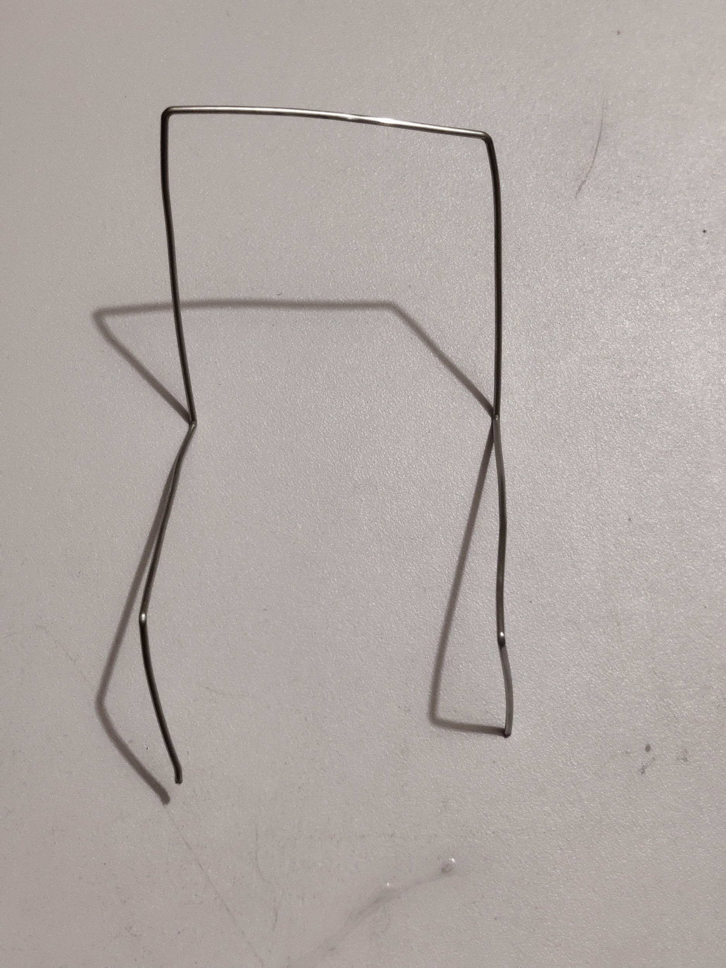
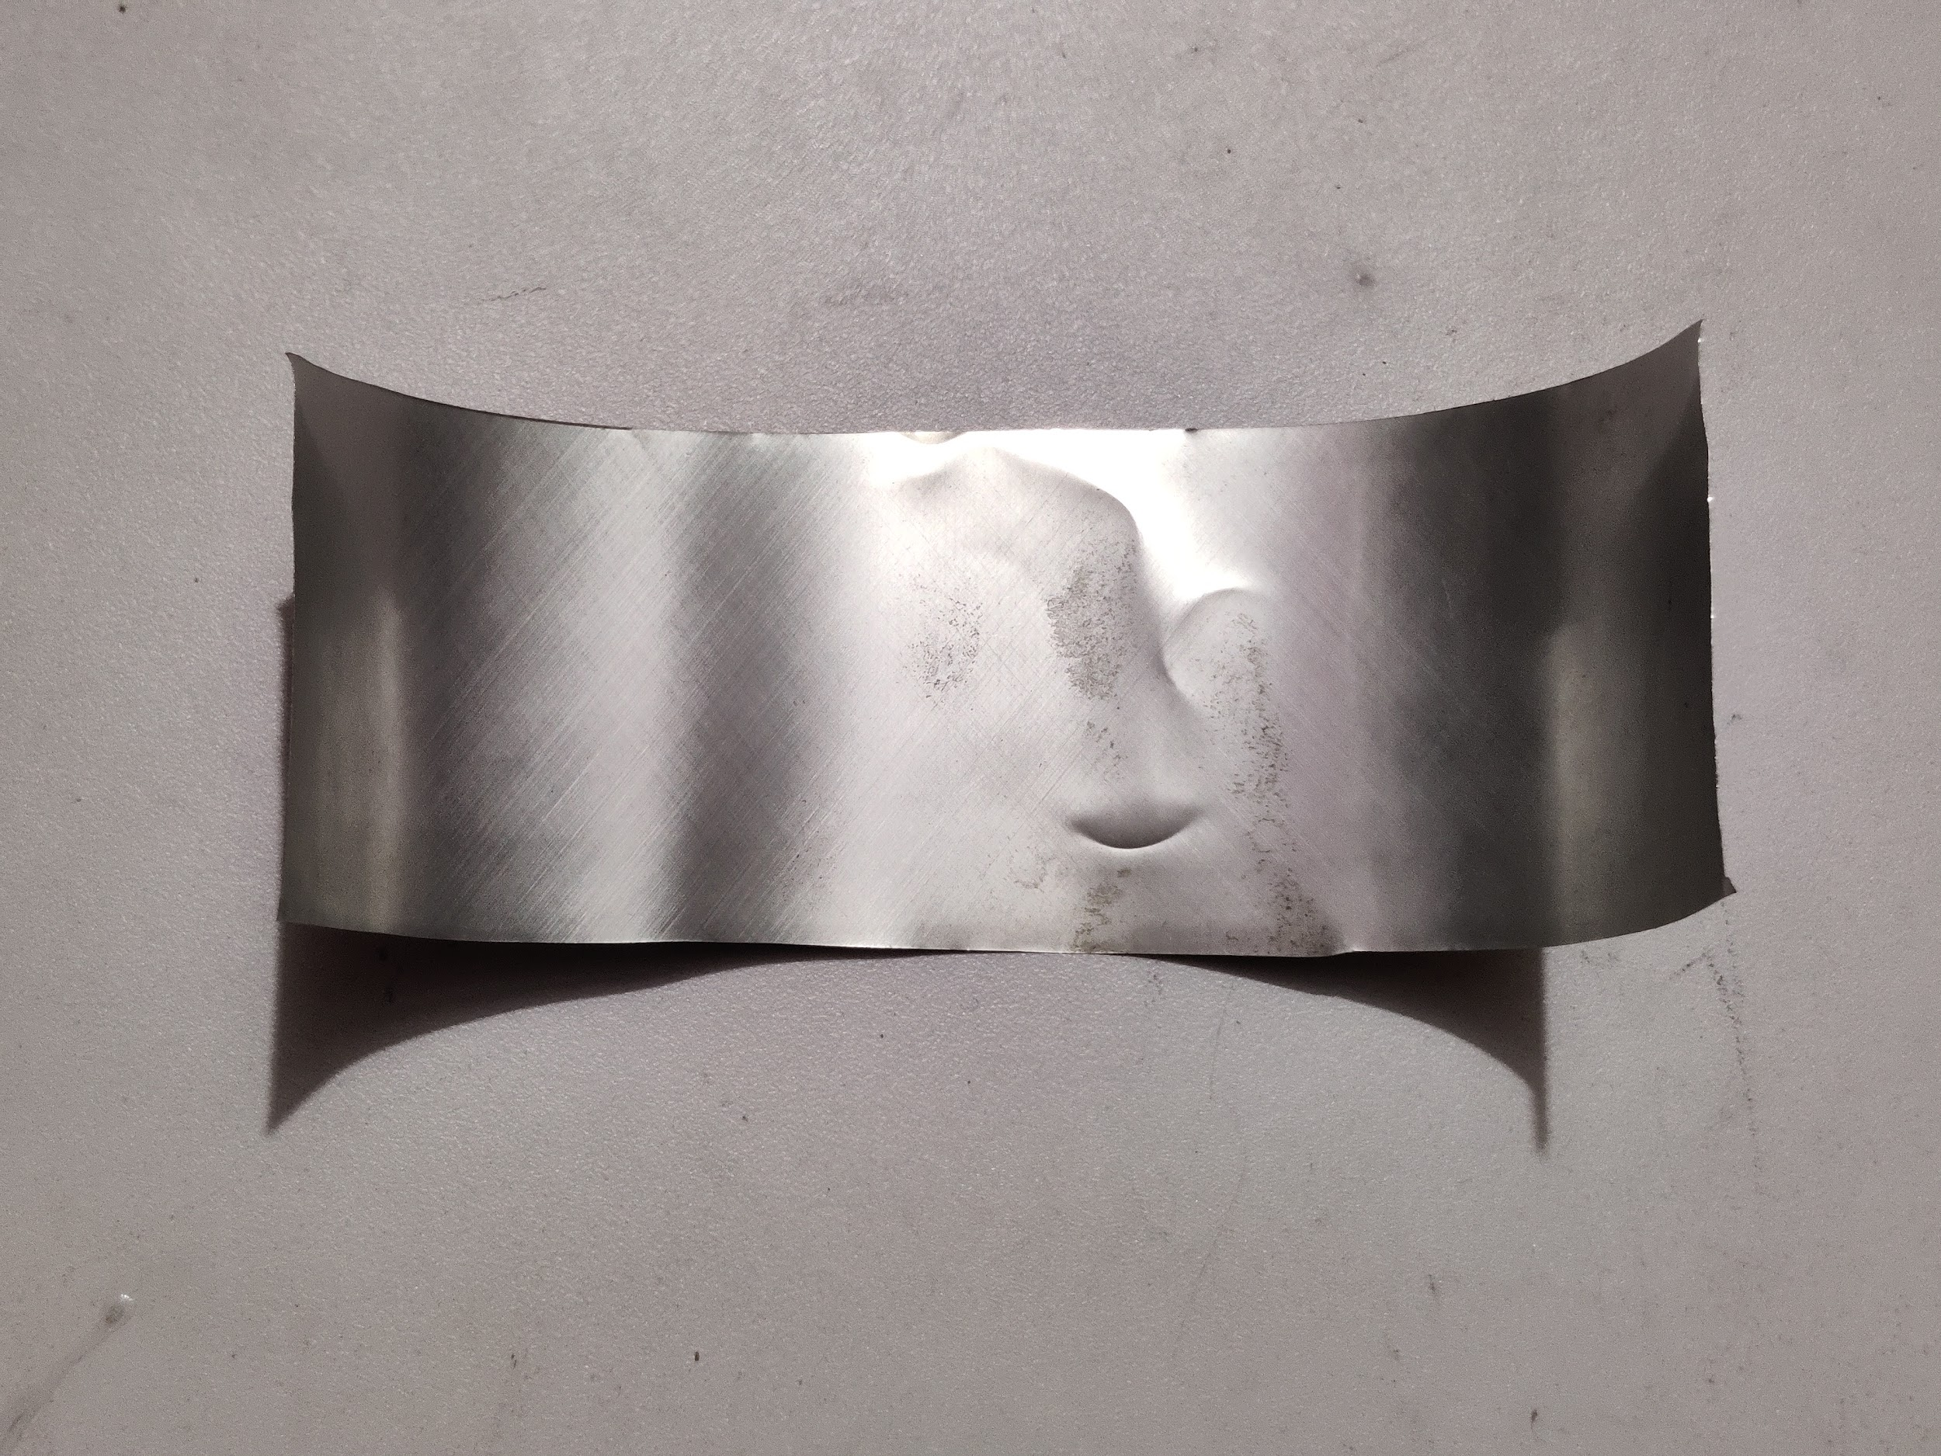
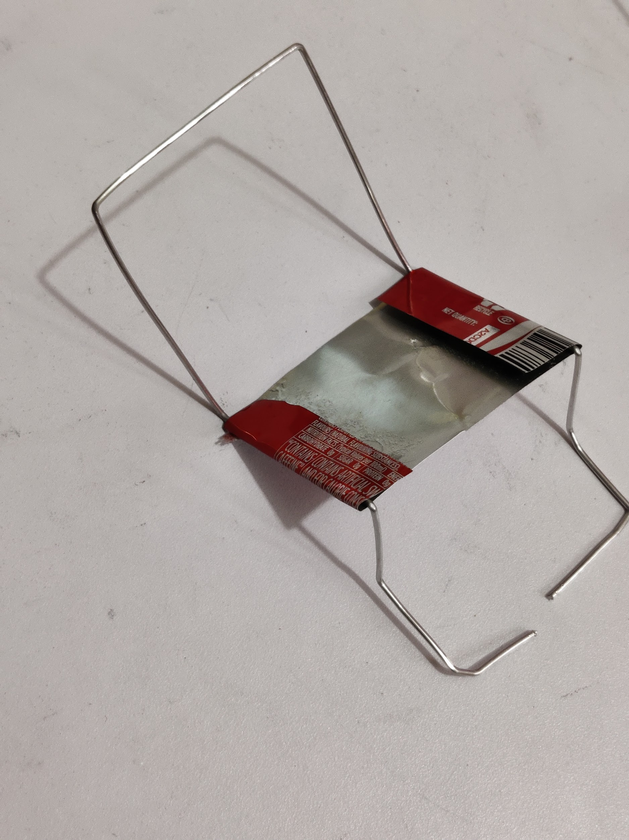
PROCESS OF MAKING CHAIRS:
+
Processes Involved:
1. Bending 2. Cutting 3. Adhesive joining

Slide 8
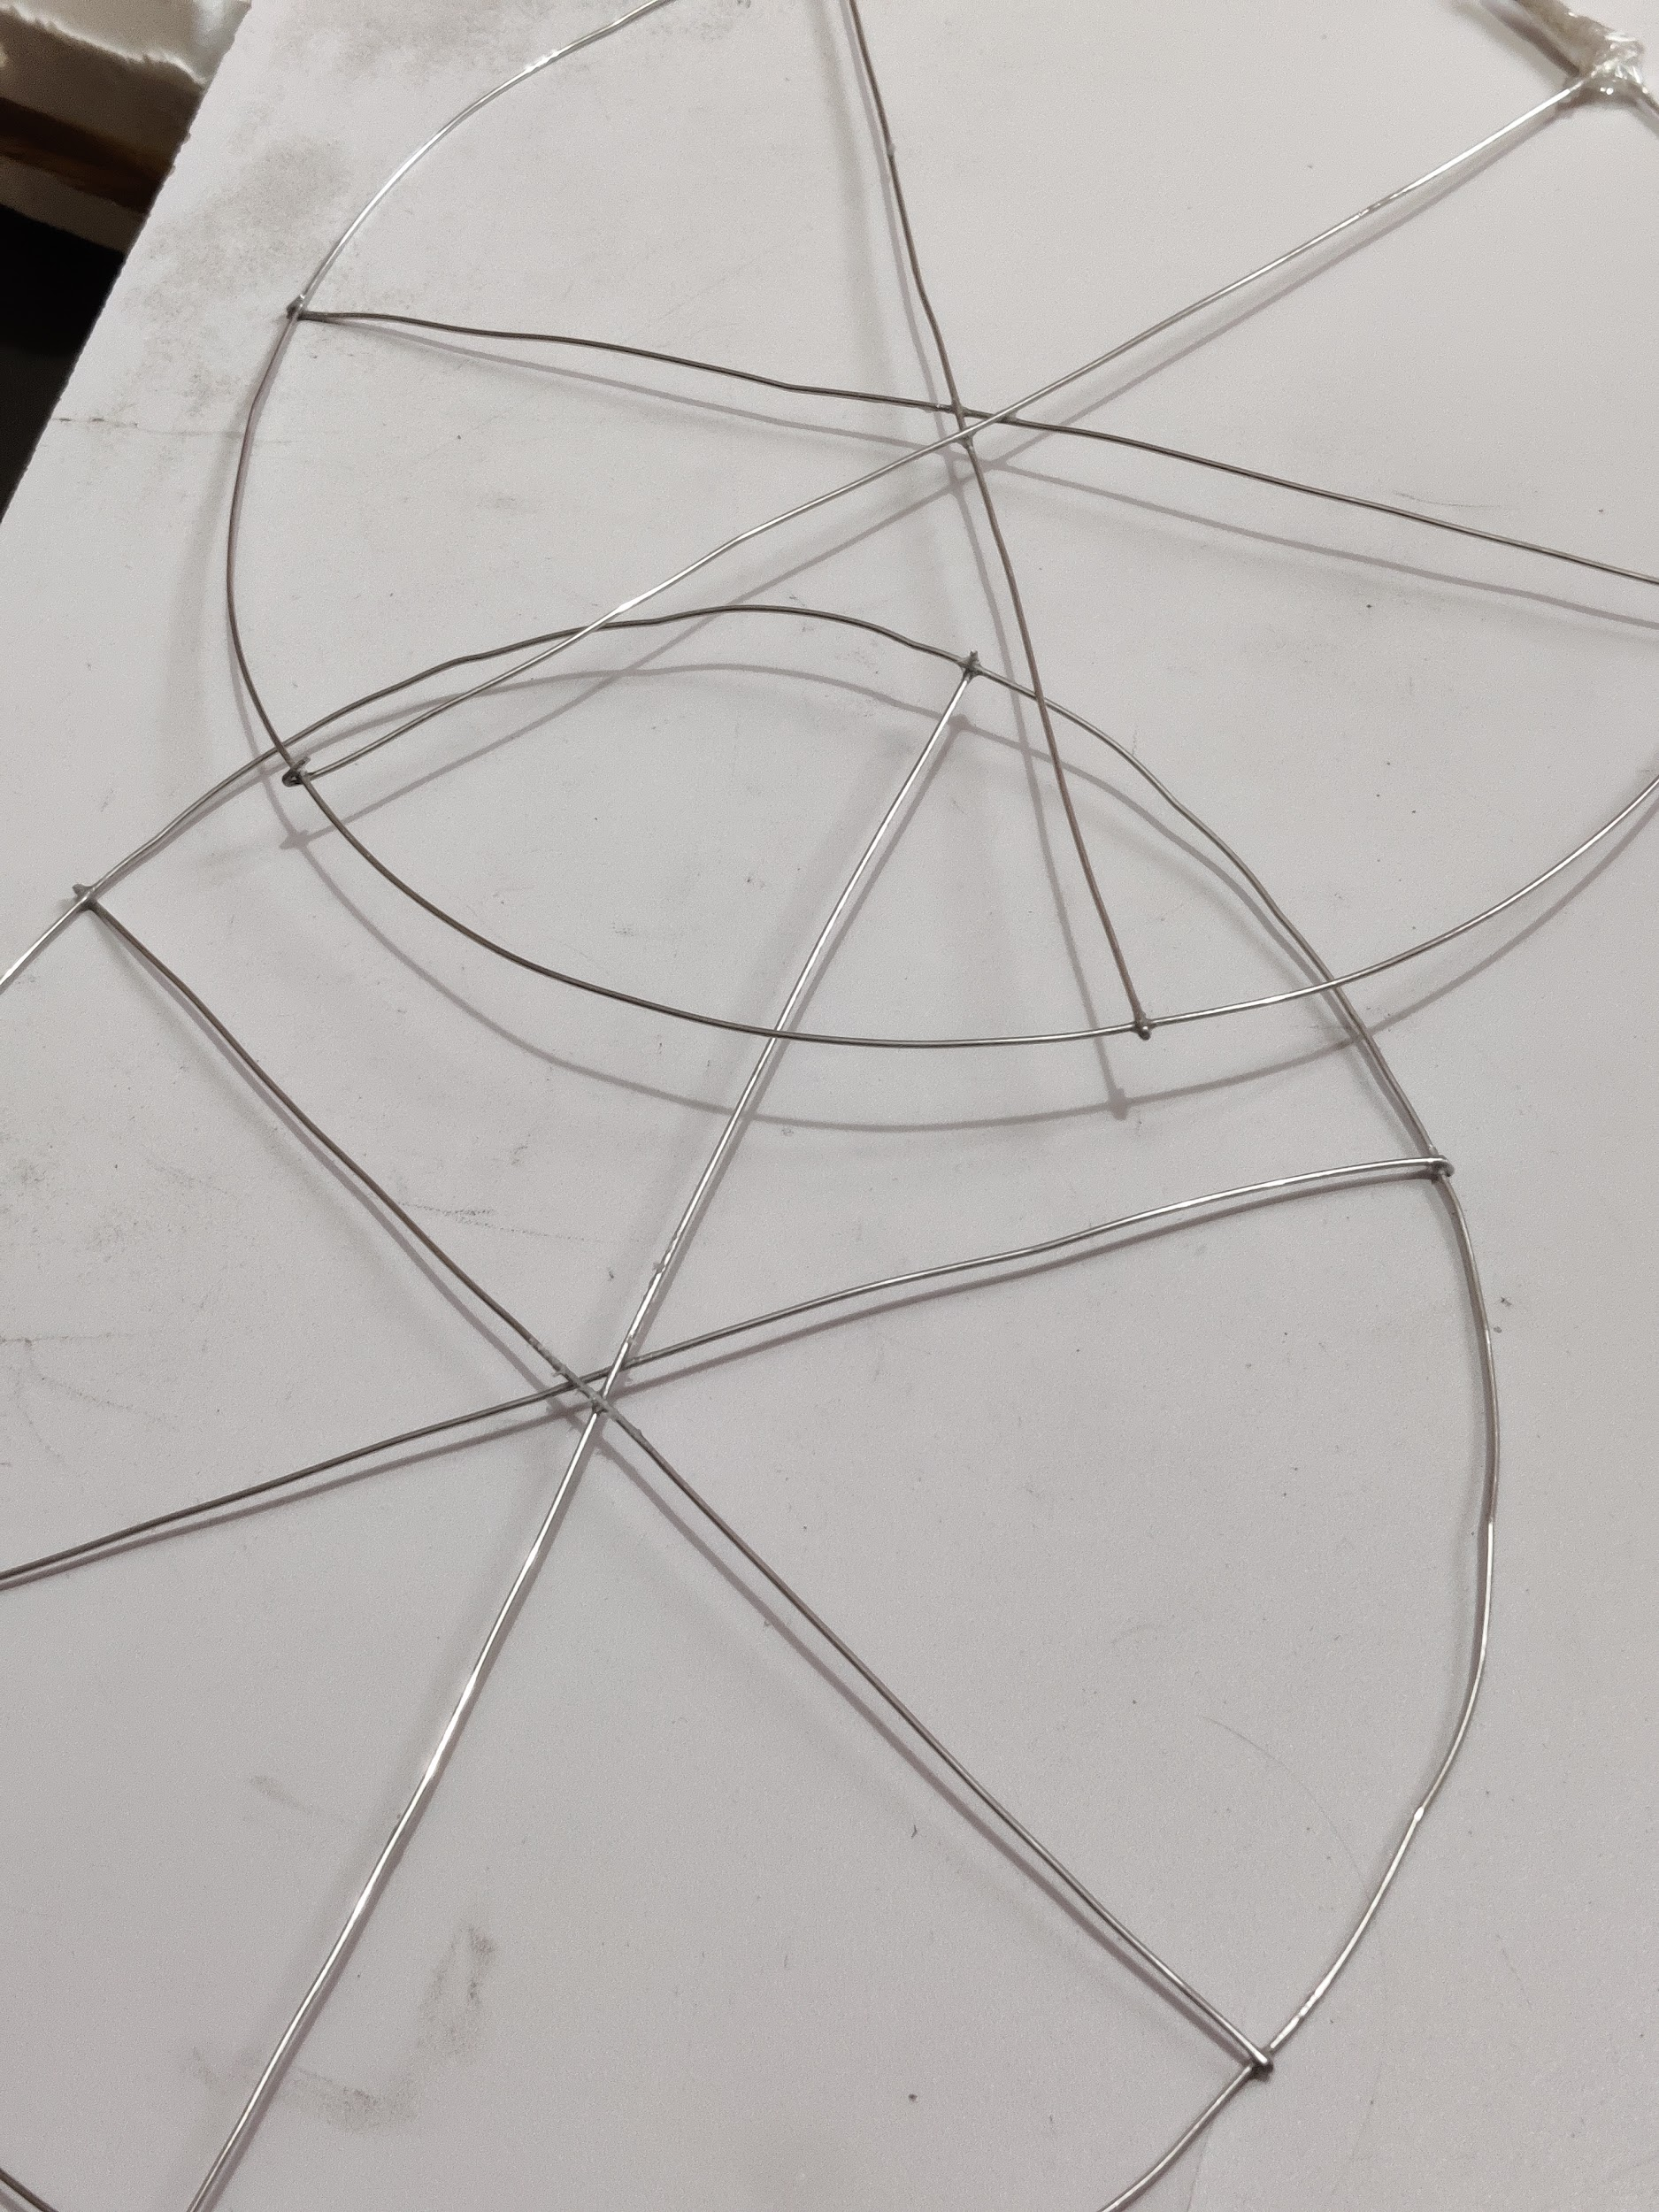
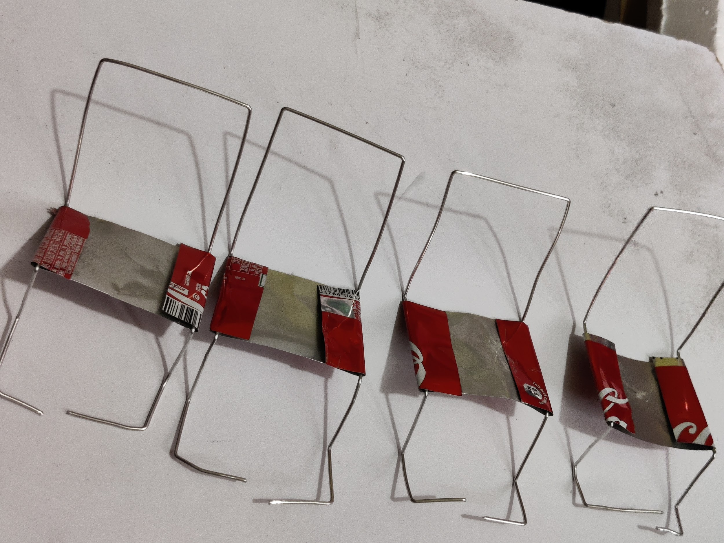
WHEELS AND CHAIRS:

Slide 9
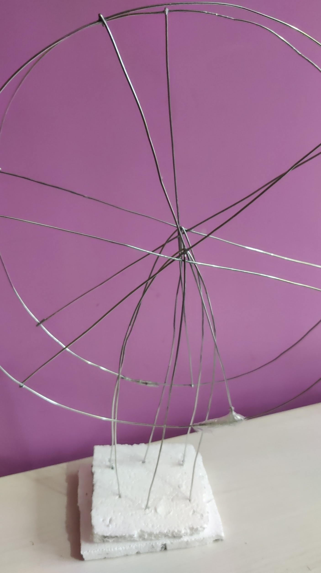
ASSEMBLY OF WHEEL TO BASE:
I have made base with thermocol and joined base with wheel using side rods and central rod.

Slide 10
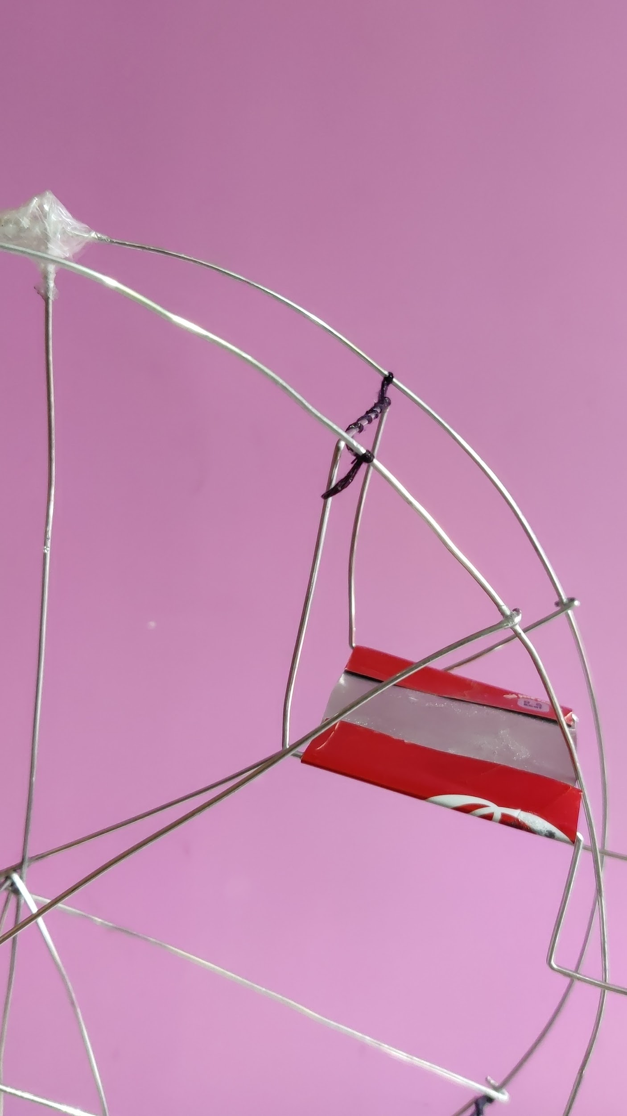
ASSEMBLY OF CHAIR TO BASE:
I have made hook to chair and hanged it to rods of wheel.

Slide 11
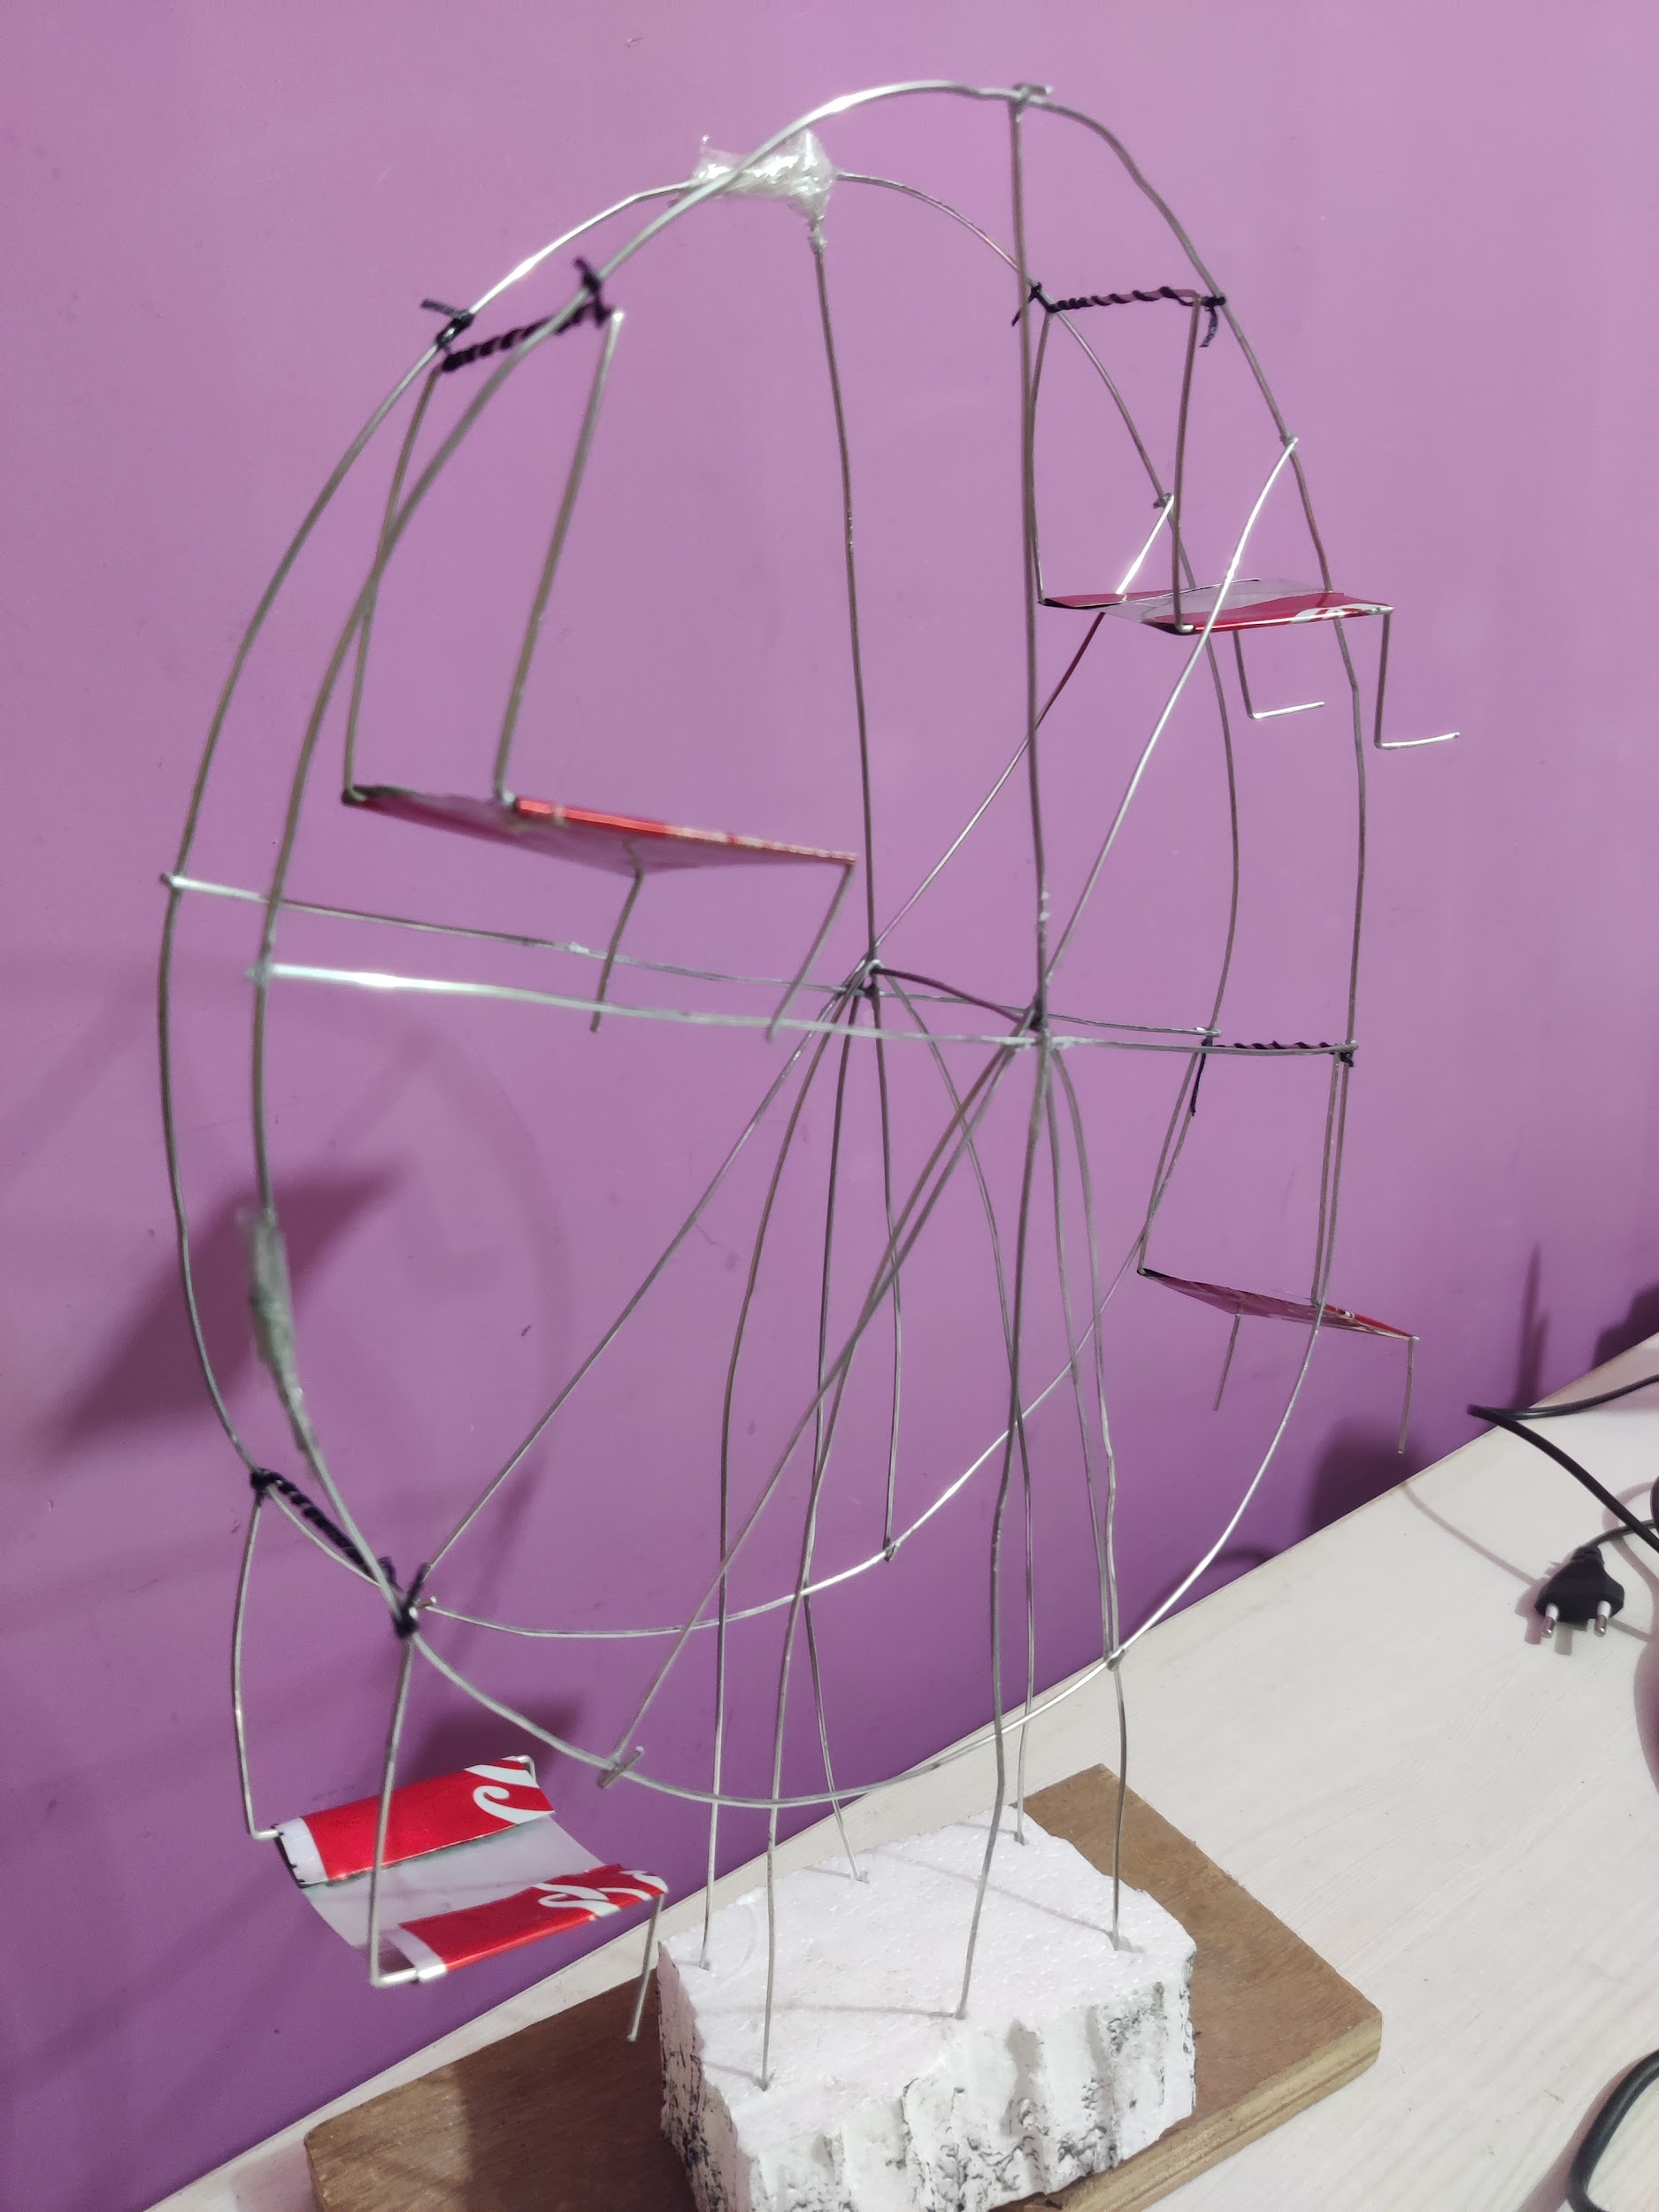
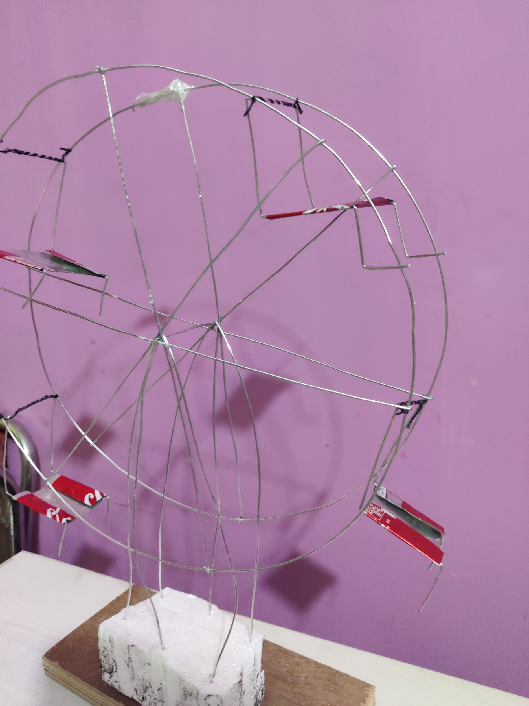
FINAL MODEL:

Slide 12
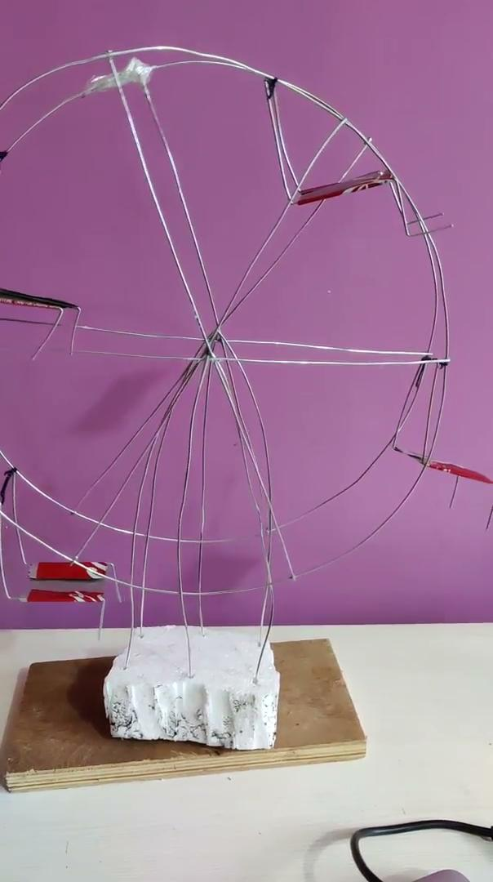
VIDEO OF GIANT WHEEL:

Slide 13
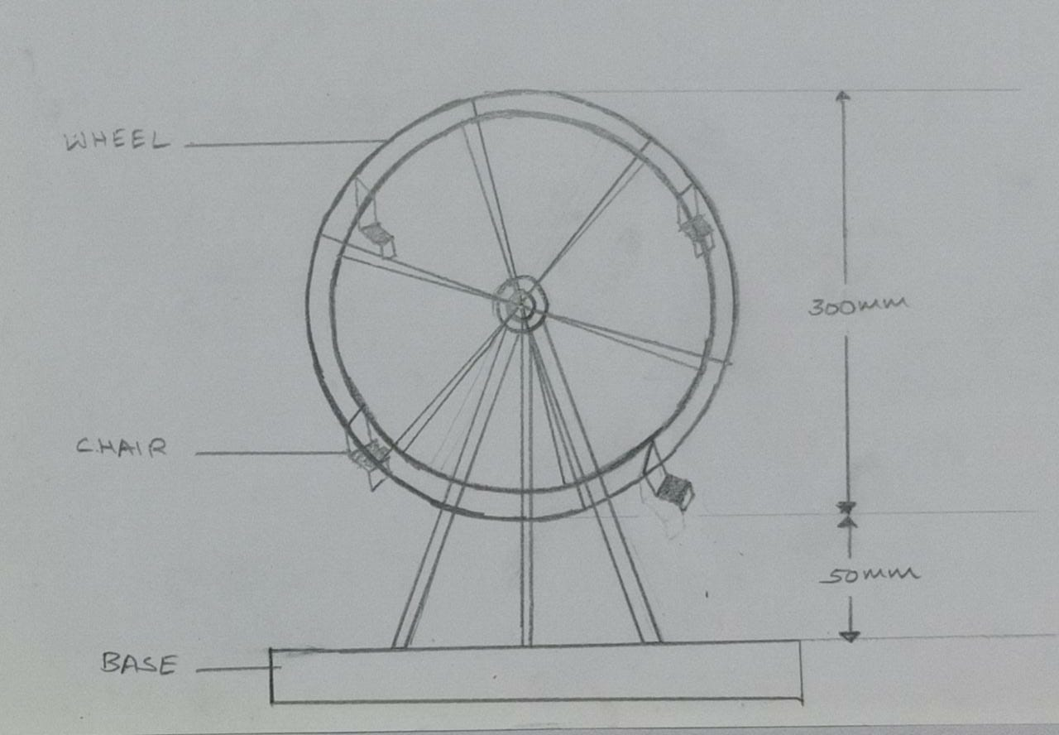
ISOMETRIC DRAWING:

Slide 14
CHALLENGES:
I faced challenge in bending wire with pliers to form an accurate circular shape for the wheel.

Slide 15
THANK YOU!

